Slide 1
A hands-on tutorial: Working with Smart Contracts in
Ethereum

Slide 2
Different tools provide different functionality
 | Tools Activities | Remix | Ganache | MyEtherWallet | Geth
1 | Configure the Blockchain | - | - | - | +
2 | Deploy the Blockchain | Not Persistent | + | - | +
3 | Develop the contract | + | - | - | +
4 | Compile the contract | + | - | - | +
5 | Create user account | + | + | + | +
6 | Deploy the contract | + | - | + | +
7 | Create the UI for interacting | + | - | + | +
8 | Run the client | + | - | + | +
9 | Interact with the contract & have fun | + | - | + | +
10 | Monitor the execution | - | + | - | +
1
3
2
4
5
6
8
7
9
https://remix.ethereum.org/ http://truffleframework.com/ganache/ https://github.com/kvhnuke/etherwallet/releases/tag/v3.21.06
10
1

Slide 3

Use which tool for what purpose? (1/2)
Use Geth for everything?
Powerful but command-line only
What should I use?
As a starting point for developing contracts – mostly Remix
What cannot Remix do?
Configure the blockchain
Create real (non-test) user accounts and transfer funds between user accounts
Monitor the execution
Other advanced operations
2

Slide 4
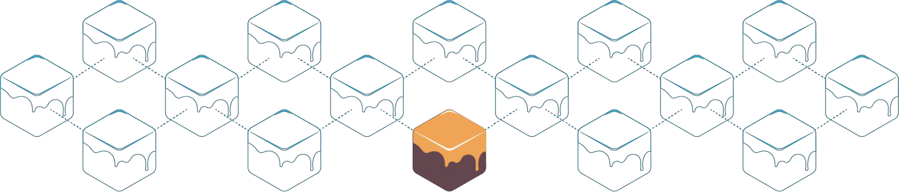
Use which tool for what purpose? (2/2)
Why use Ganache?
To inspect and monitor the execution
To visualize certain elements in a better way
Why use MyEtherWallet?
To create a personal wallet (real user account), transfer funds between user accounts, and interact with contracts
Metamask as another alternative
3

Slide 5

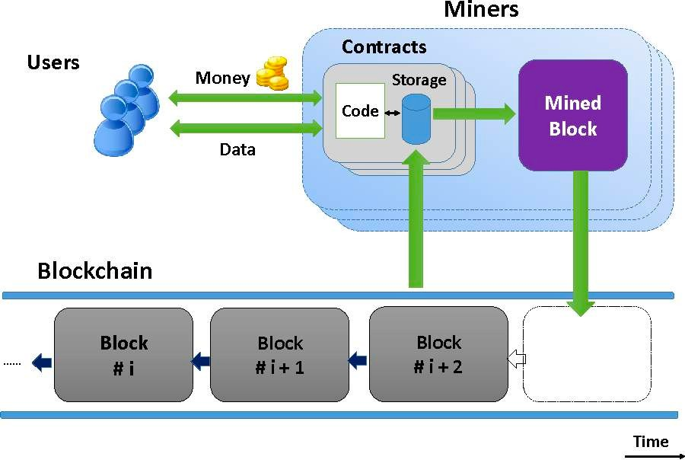
Smart Contracts
In the form of code
Stored on a blockchain
Executes under given conditions
- K. Delmolino, M. Arnett, A. E. Kosba, A. Miller, and E. Shi, “Step by Step Towards Creating a Safe Smart Contract: Lessons and Insights from a Cryptocurrency Lab,” IACR Cryptology ePrint Archive, vol. 2015, p. 460, 2015.
4

Slide 6








Smart Contracts Example (1/3)
Owner creates the contract
Contract replicates among all the nodes
Owner
Blockchain
Create
Contract
Tenant

Slide 7






Smart Contracts Example (2/3)
Tenant deposits to the contract
Contract’s State changes on all the nodes
Owner
Blockchain
Tenant
Deposit

Slide 8

Smart Contracts Example (3/3)
Owner checks the contract’s balance
Contract’s state is fetched from one node
Owner
Blockchain
Check Balance
Tenant

Slide 9
Smart Contracts
Developing a simple contract
Compiling the contract
Deploying the contract
Interacting with the contract
Adding more functions to our code to make it more practical

Slide 10

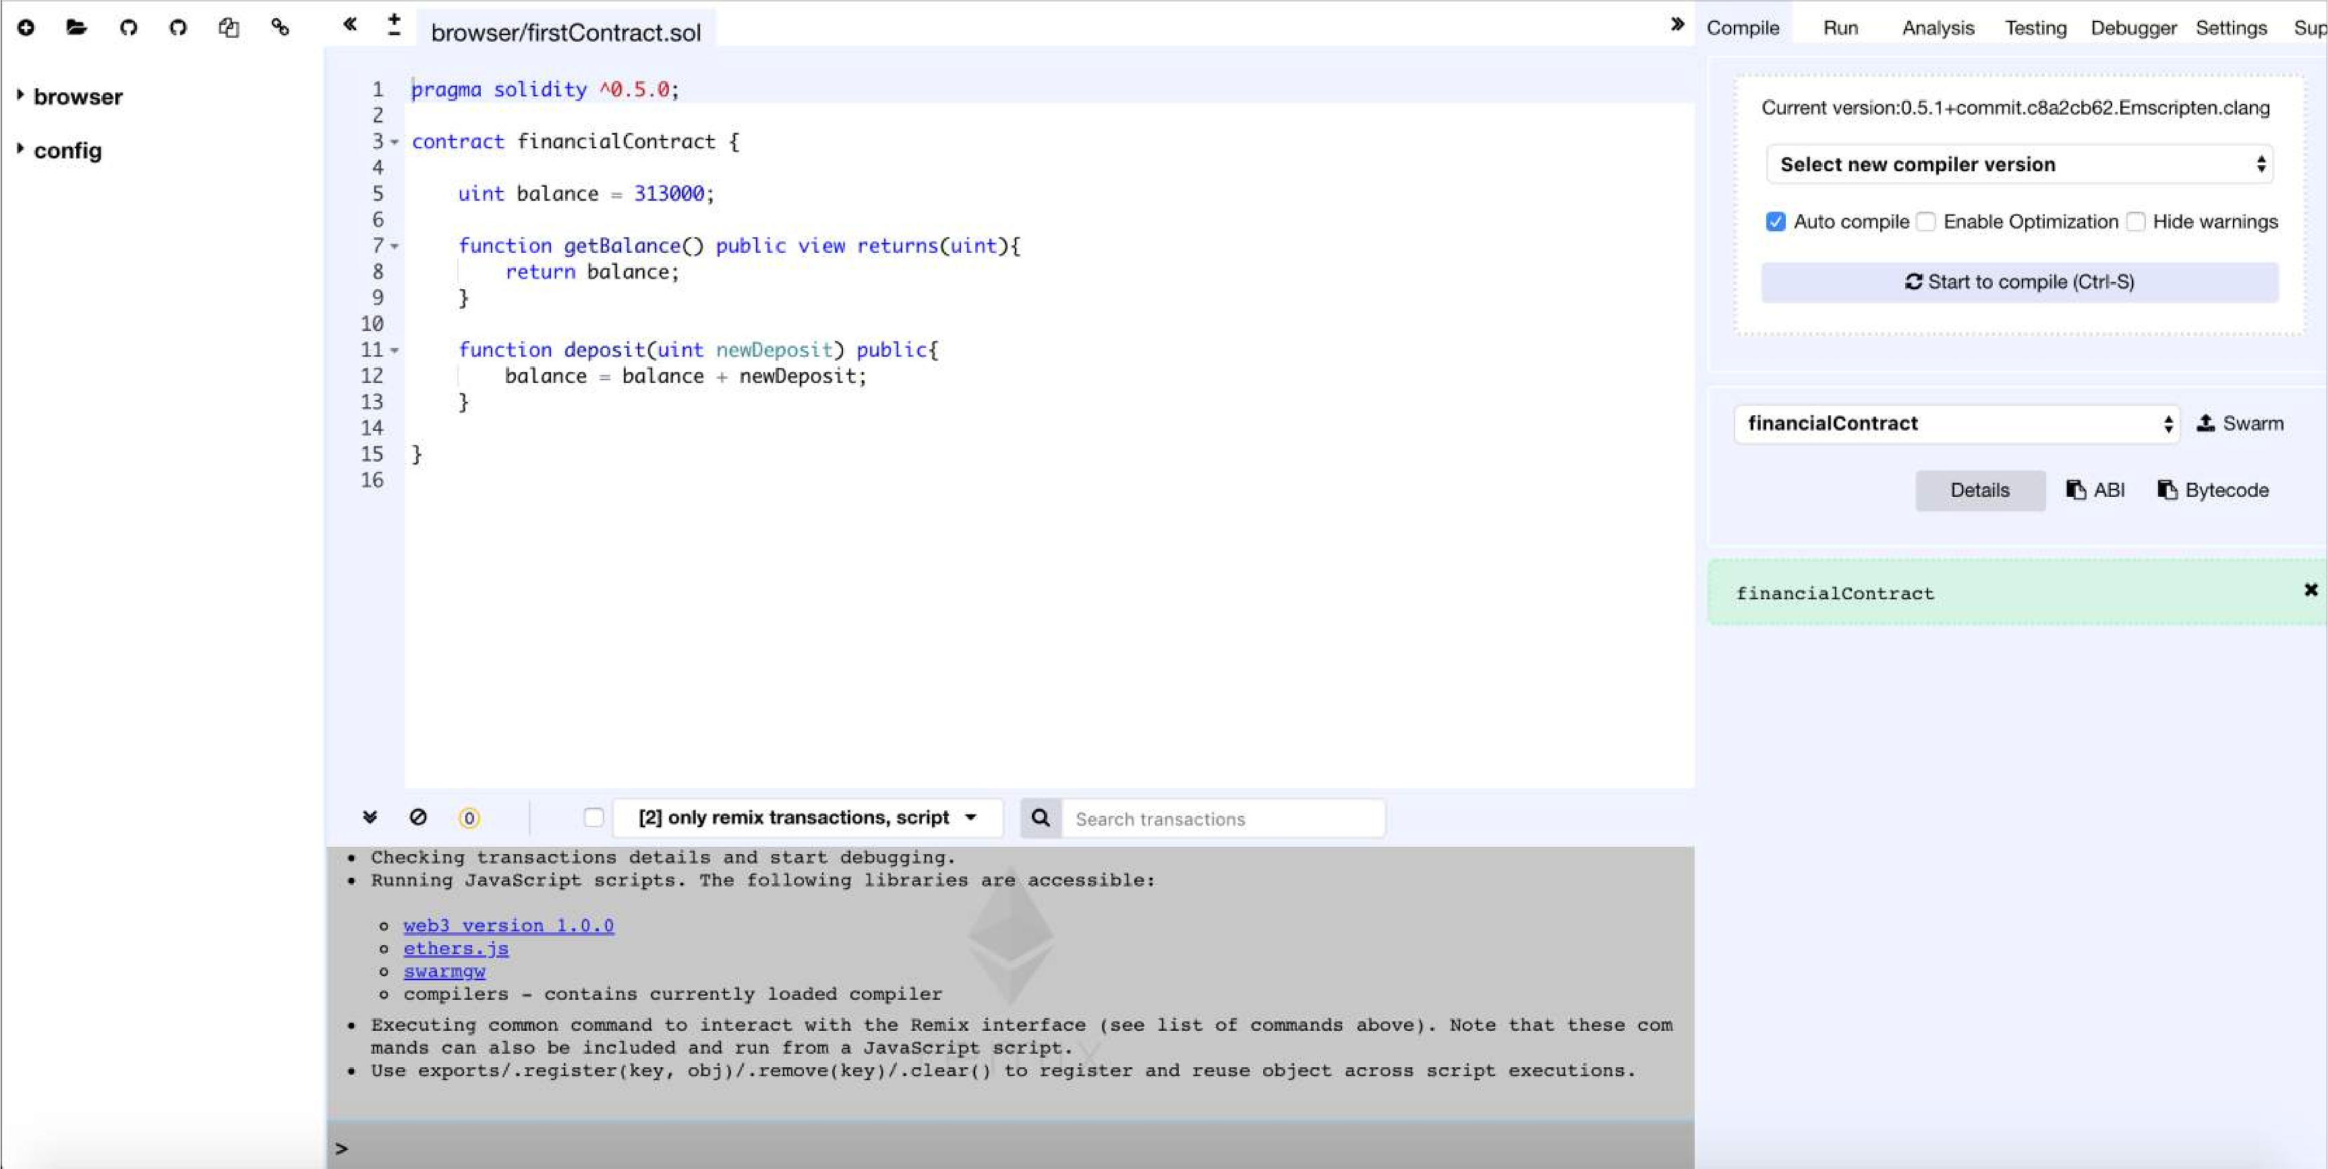
Open Remix : remix.ethereum.org
An open source tool for writing, compiling and testing Solidity contracts

Slide 11

Solidity
Object-oriented
Contract-oriented
High-level language
Influenced by C++, Python, and JavaScript
Target Ethereum Virtual Machine (EVM)
Serpent as an Alternative?
Low-level language
Complex compiler

Slide 12

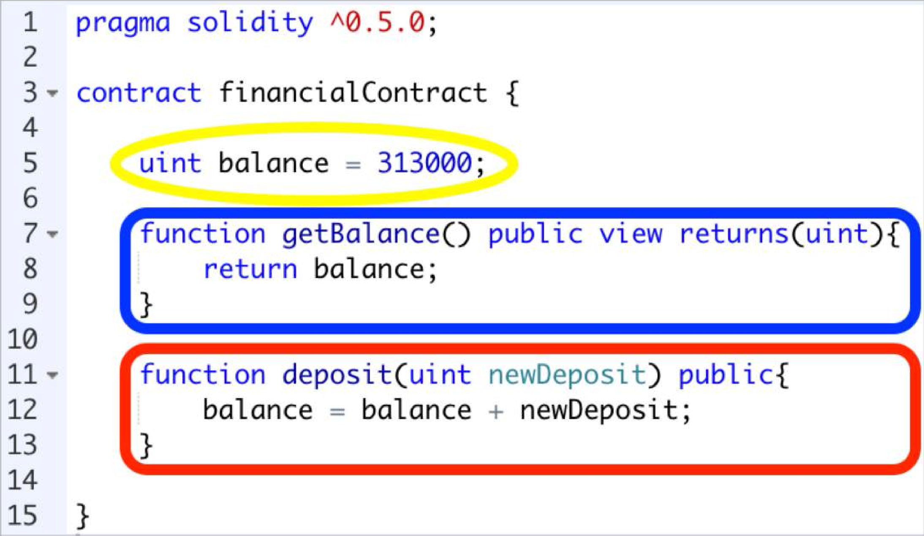
Start Coding
Setter and Getter: Set and get the information.
Variable
Getter function
Setter function

Slide 13

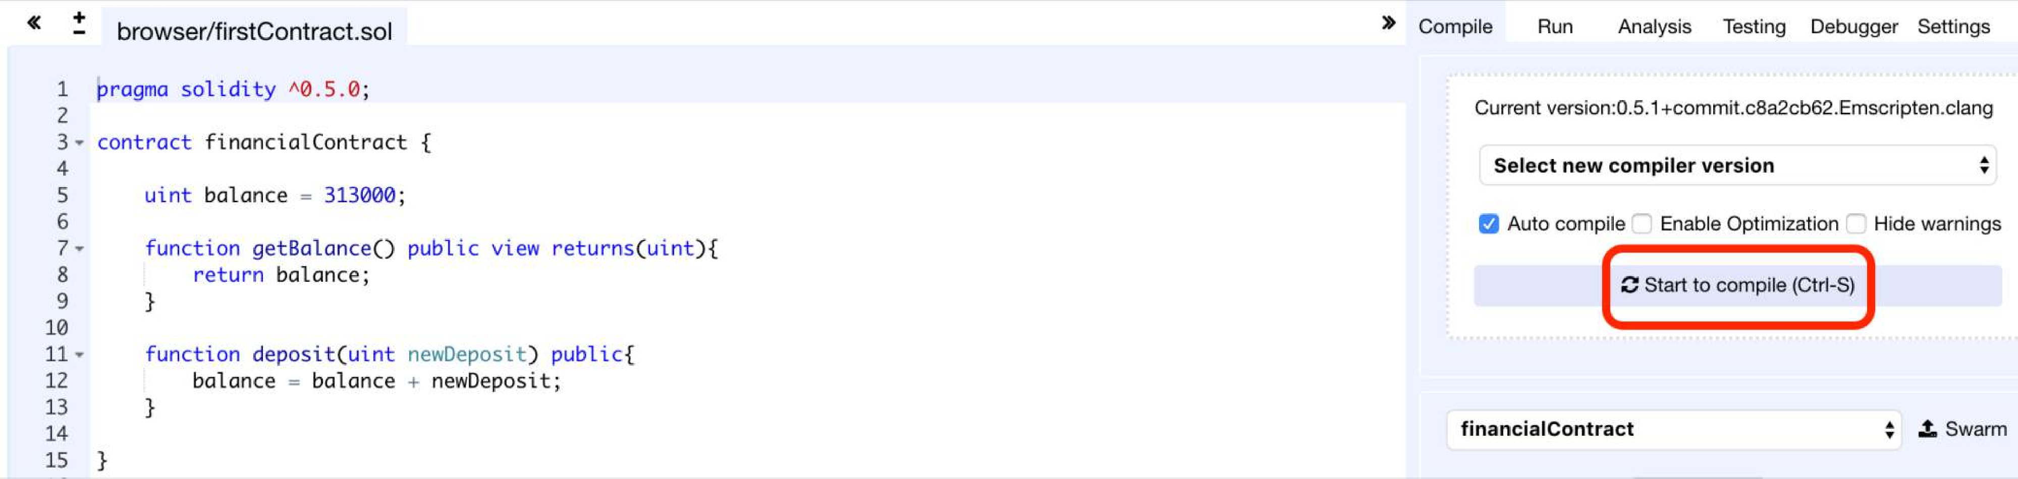
Compile the Contract
Compile tab: Start to compile button

Slide 14

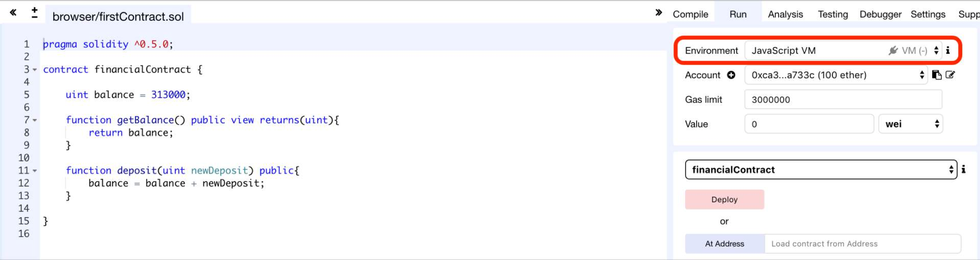
Set Deployment Parameters (1/2)
Run tab: Environment = JavaScript VM

Slide 15
Set Deployment Parameters (2/2)
JavaScript VM: All the transactions will be executed in a sandbox blockchain in the browser. Nothing will be persisted and a page reload will restart a new blockchain from scratch, the old one will not be saved.
Injected Provider: Remix will connect to an injected web3 provider. Mist and Metamask are example of providers that inject web3, thus they can be used with this option.
Web3 Provider: Remix will connect to a remote node. You will need to provide the URL address to the selected provider: geth, parity or any Ethereum client.
Gas Limit: The maximum amount of gas that can be set for all the instructions of a contract.
Value: Input some ether with the next created transaction (wei = 10⁻¹⁸ of ether).

Slide 16
Types of Blockchain Deployment
Private: e.g., Ganache sets a personal Ethereum blockchain for running tests, executing commands, and inspecting the state while controlling how the chain operates.
Public Test (Testnet): Like Ropsten, Kovan and Rinkeby which are existing public blockchains used for testing and which do not use real funds. Use faucet for receiving initial virtual funds.
Public Real (Mainnet): Like Bitcoin and Ethereum which are used for real and which available for everybody to join.

Slide 17

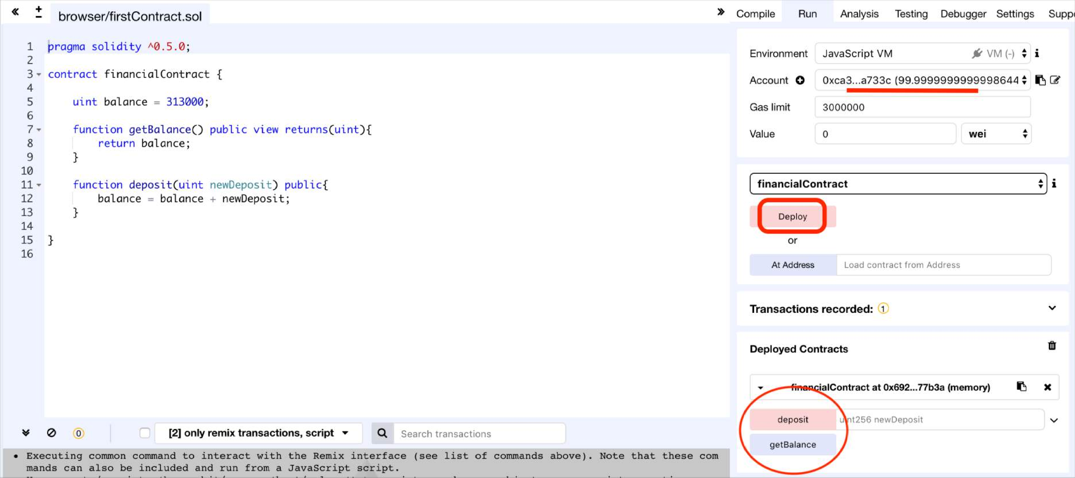
Deploy the Contract on the Private Blockchain of Remix
Run tab: Deploy button

Slide 18

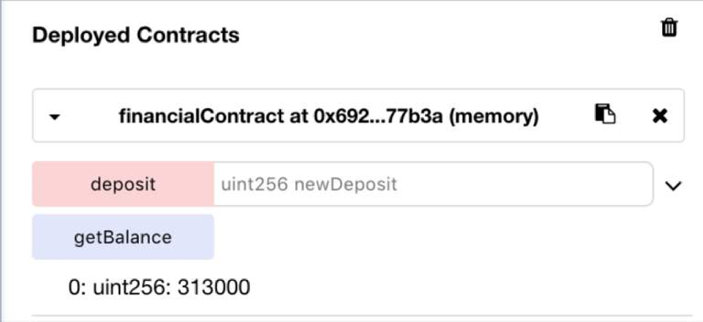

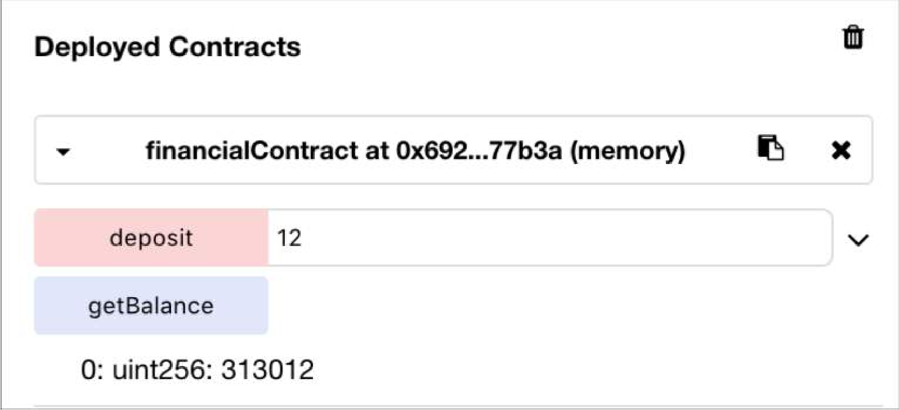
Interact with the Contract
Setter = Red Button: Creates transaction
Getter= Blue Button: Just gives information
Press getBalance to see the initial amount
1
Input a value and press deposit button to create and confirm the transaction
2
Press getBalance again to see the result
3

Slide 19
Additional features
Transferring funds from an account to the contract
Saving the address of the contract creator
Limiting the users’ access to functions
Withdrawing funds from the contract to an account

Slide 20

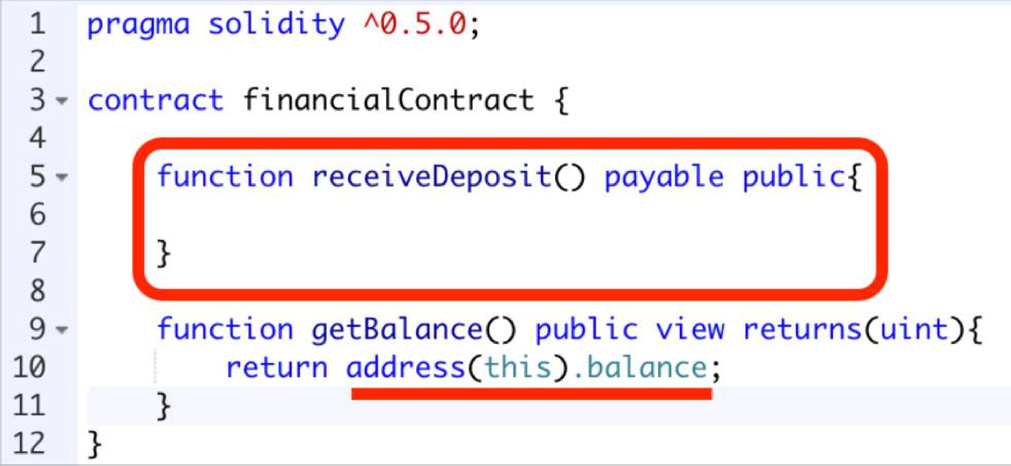
Receive ether (1/2)
Transfer money to the contract
Payable keyword allows receiving ether
Hidden Code:
Address(this).balance += msg.value;
We can get the balance of the contract
19

Slide 21

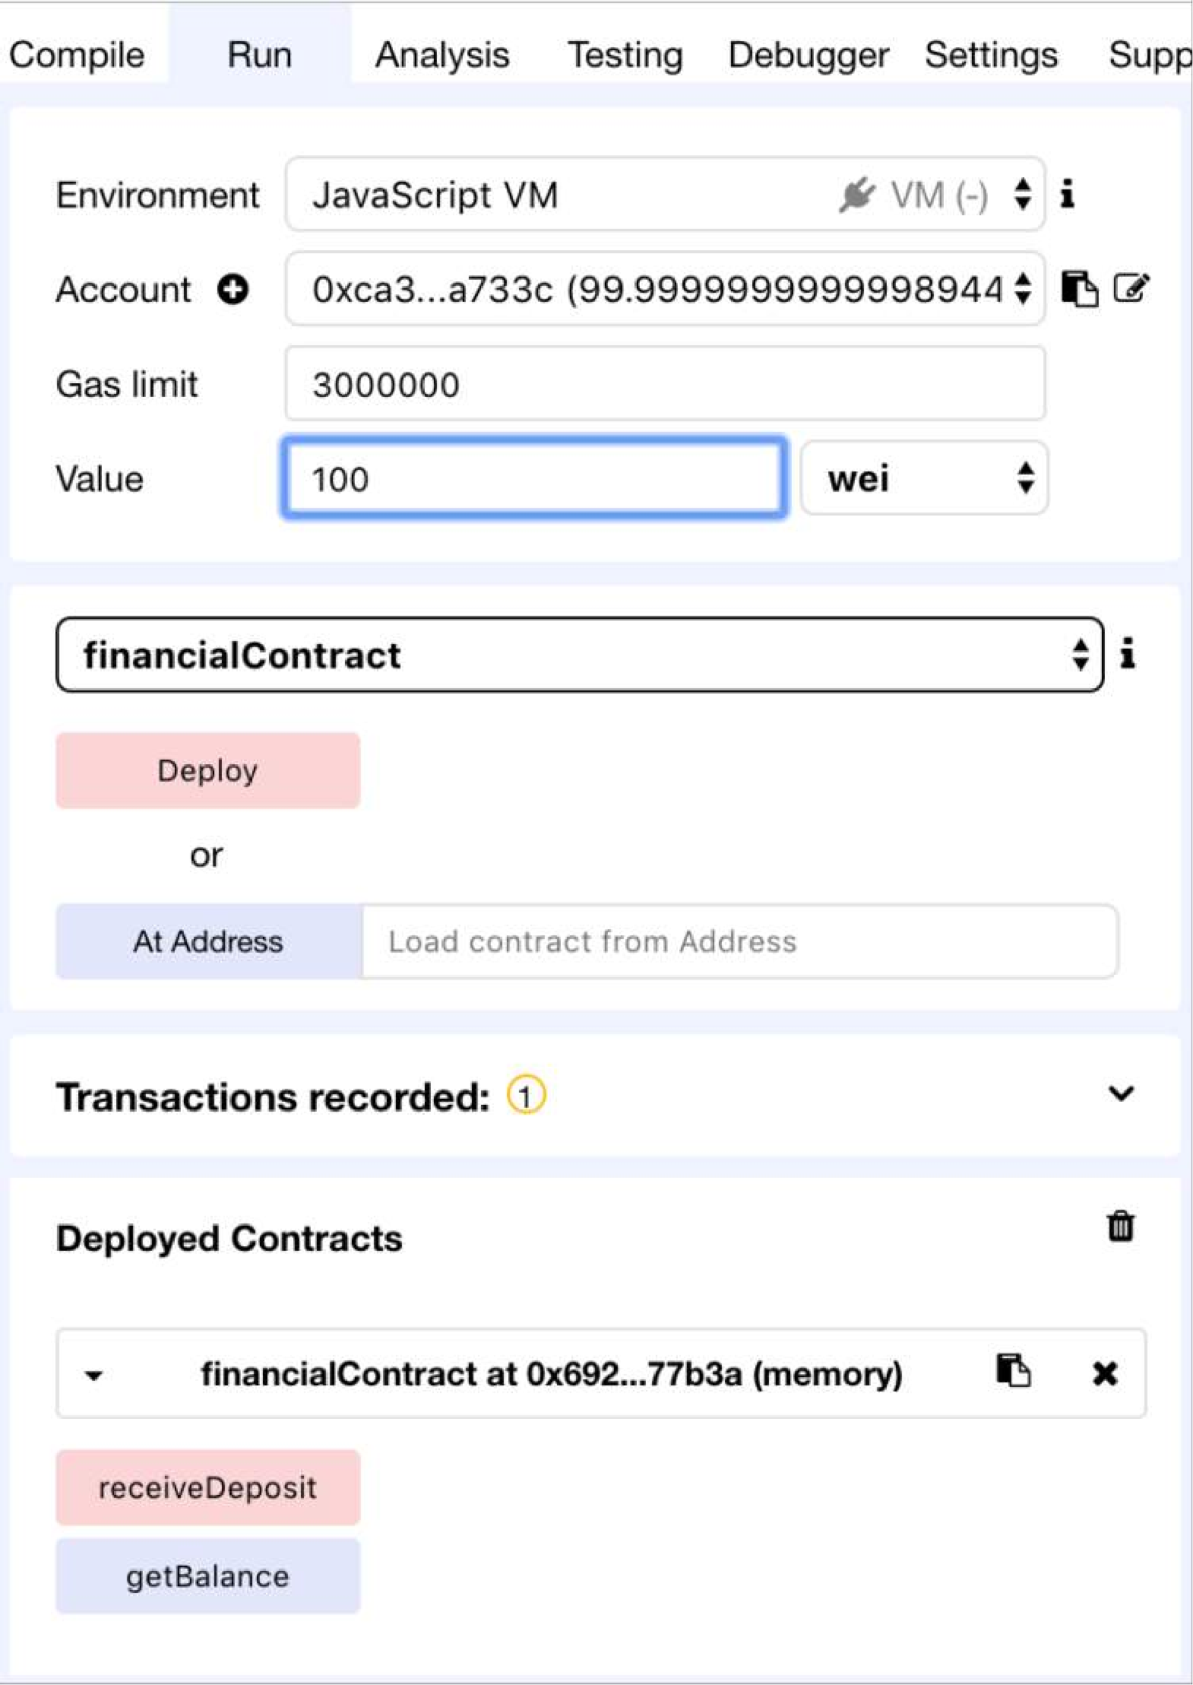
Receive ether (2/2)
Input the value as wei (10⁻¹⁸ of ether)
1
Click the receiveDeposit button to transfer the money to the contract
2

Slide 22

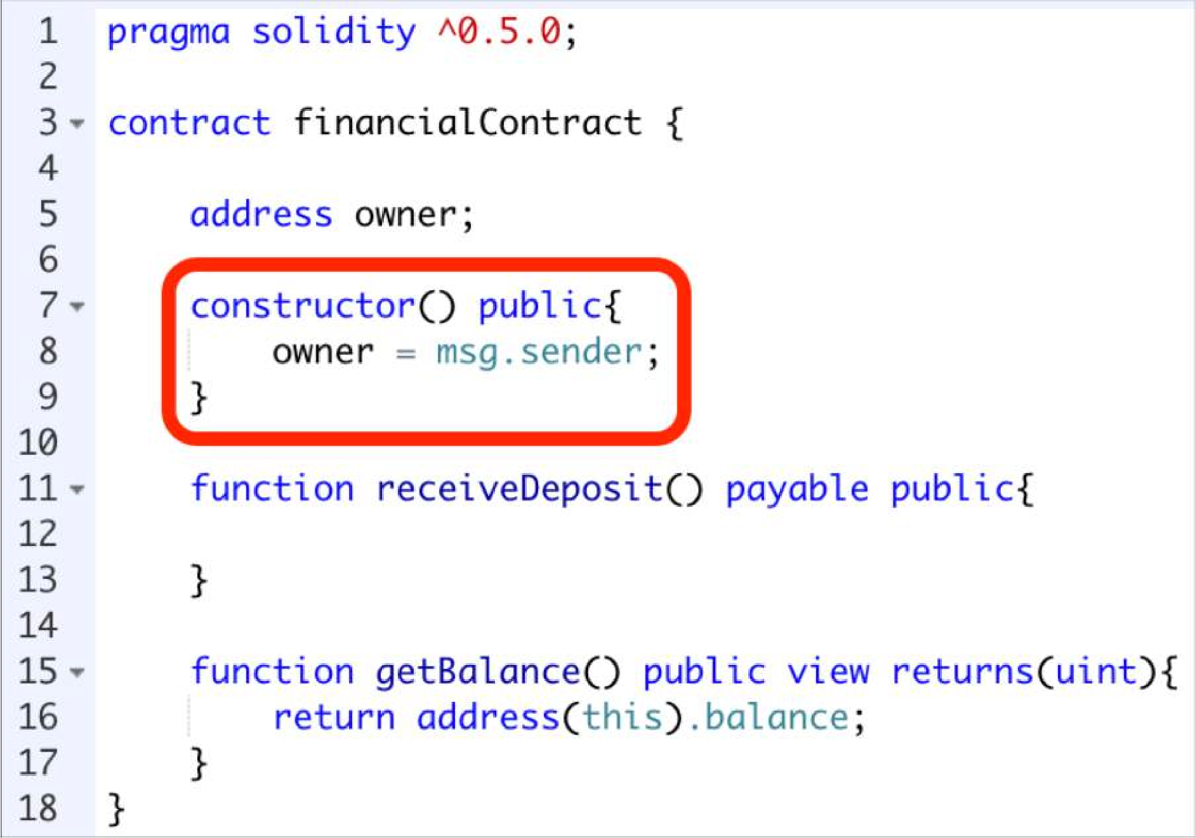
Constructor
Will be called at the creation of the instance of the contract
We want to save the address of the contract creator

Slide 23

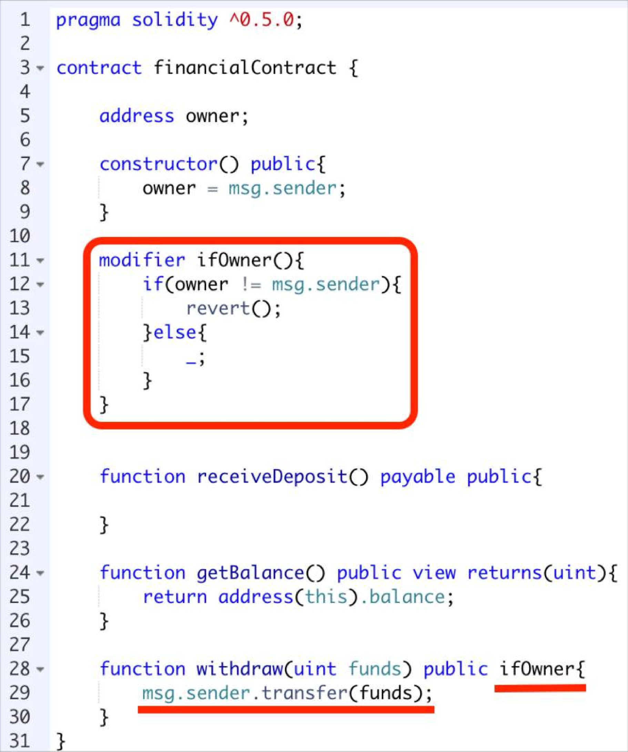
Withdraw funds
Modifier: Conditions you want to test in other functions
First the modifier will execute, then the invoked function
Only the contract’s creator is permitted to withdraw
Transfer some money from the contract’s balance to the owner

Slide 24
Now deploying a smart contract on an external blockchain
 | Tools Activities | Remix | Ganache | MyEtherWallet | Geth
1 | Configuring the Blockchain | - | - | - | +
2 | Deploying the Blockchain | Not Persistent | + | - | +
3 | Developing the contract | + | - | - | +
4 | Compiling the contract | + | - | - | +
5 | Creating user account | + | + | + | +
6 | Deploying the contract | + | - | + | +
7 | Creating the UI for interacting | + | - | + | +
8 | Run the client | + | - | + | +
9 | Interact with the contract & have fun | + | - | + | +
10 | Monitoring the execution | - | + | - | +

Slide 25

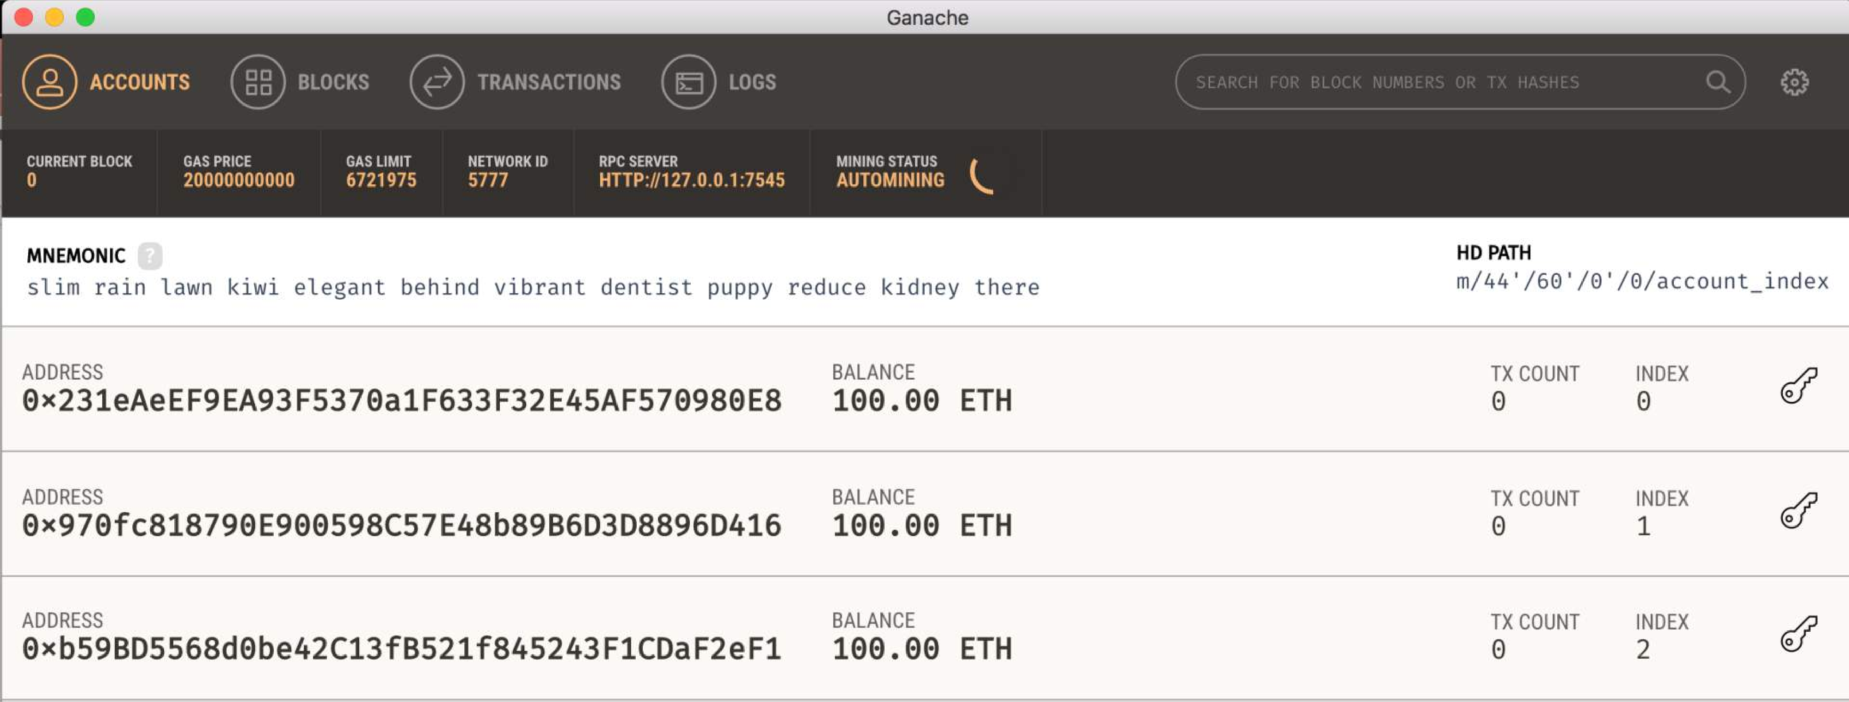
Run Ganache

Slide 26

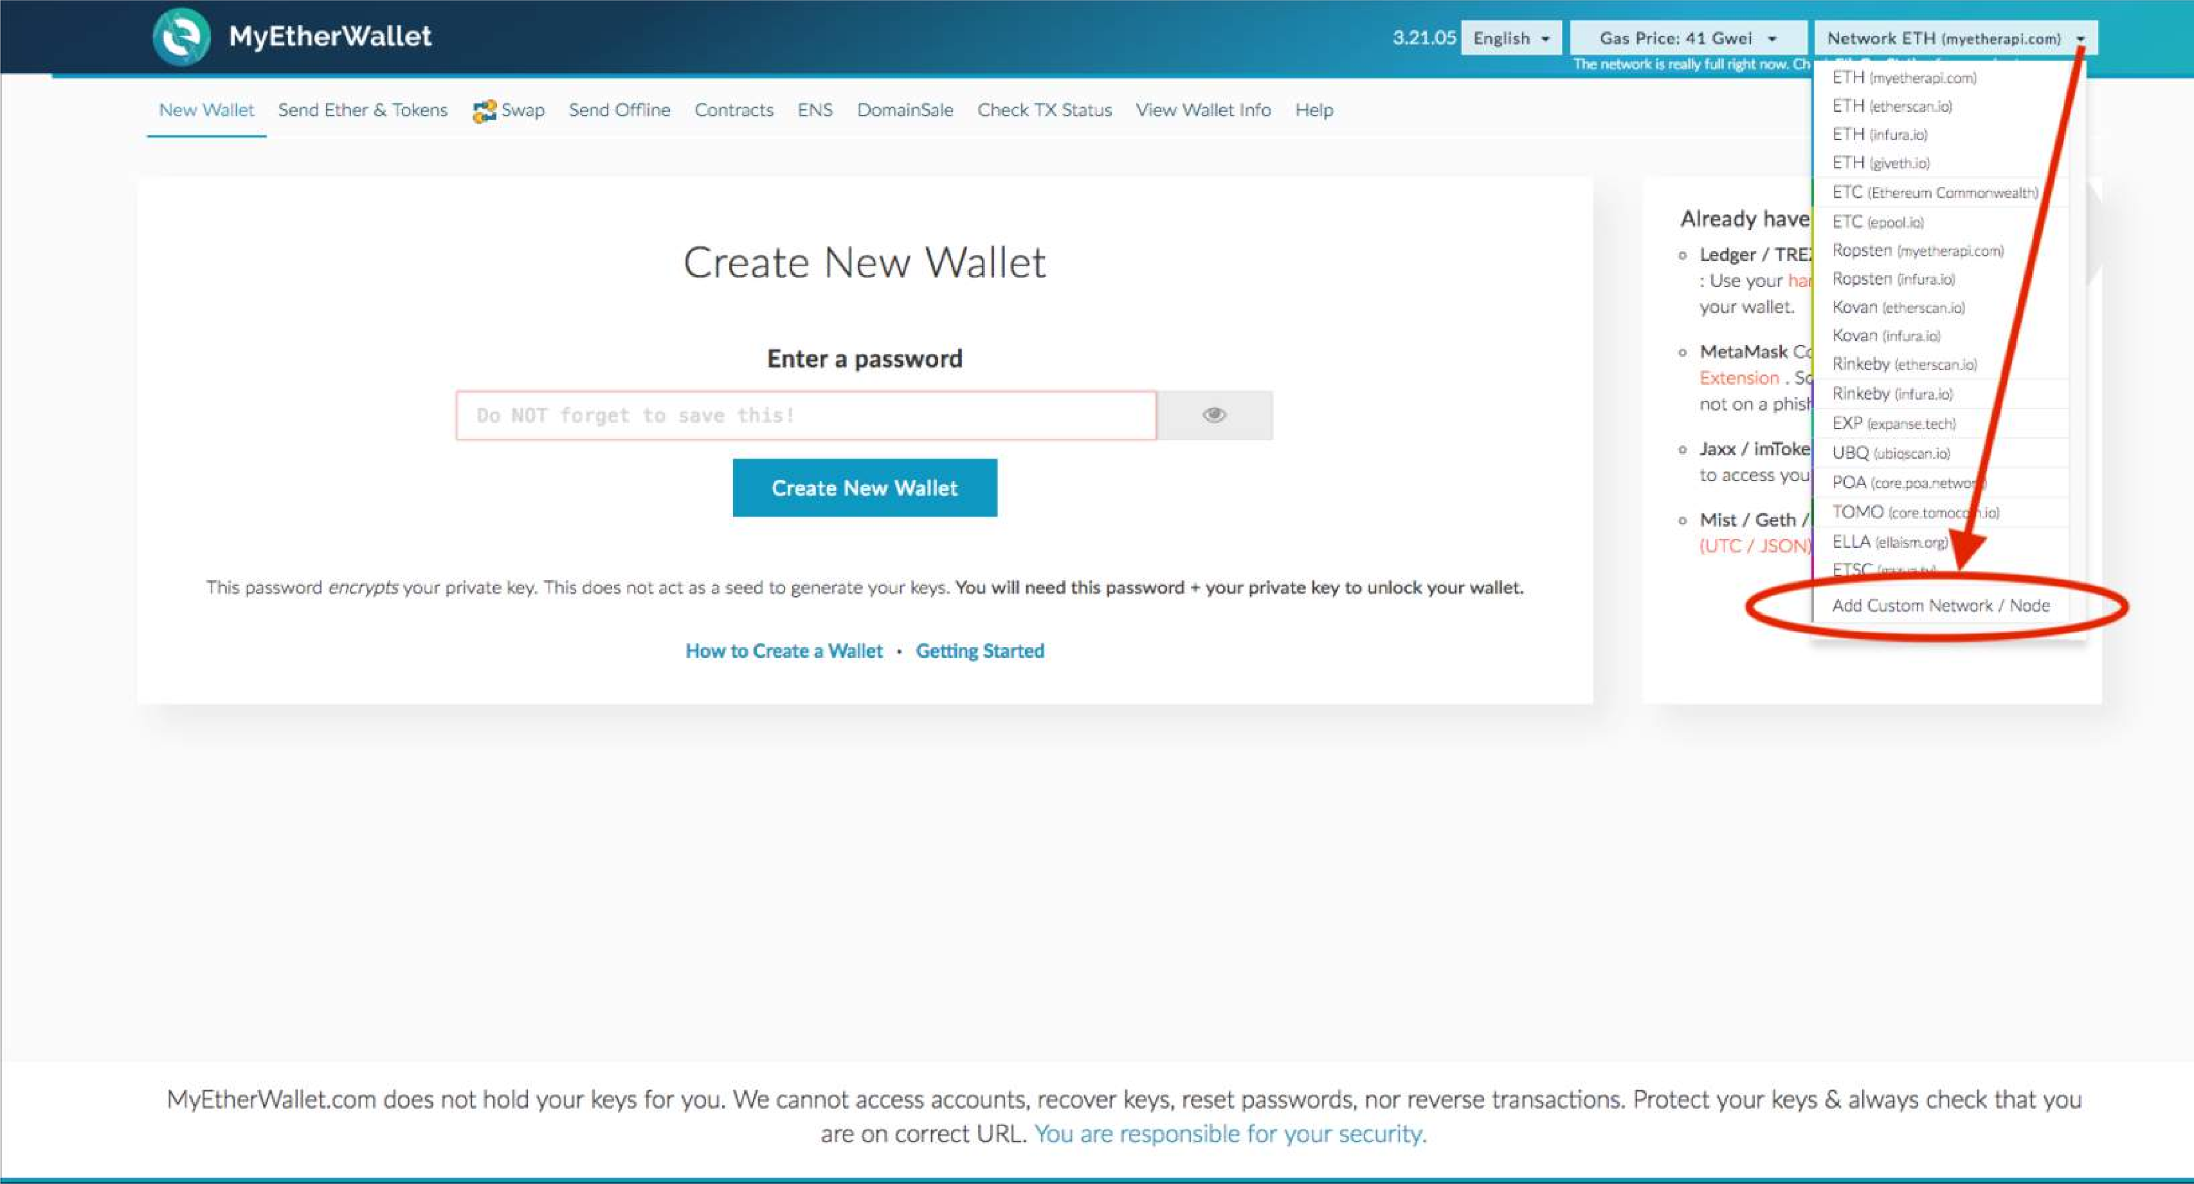
MyEtherWallet
add your custom network that you want to test your contracts on

Slide 27

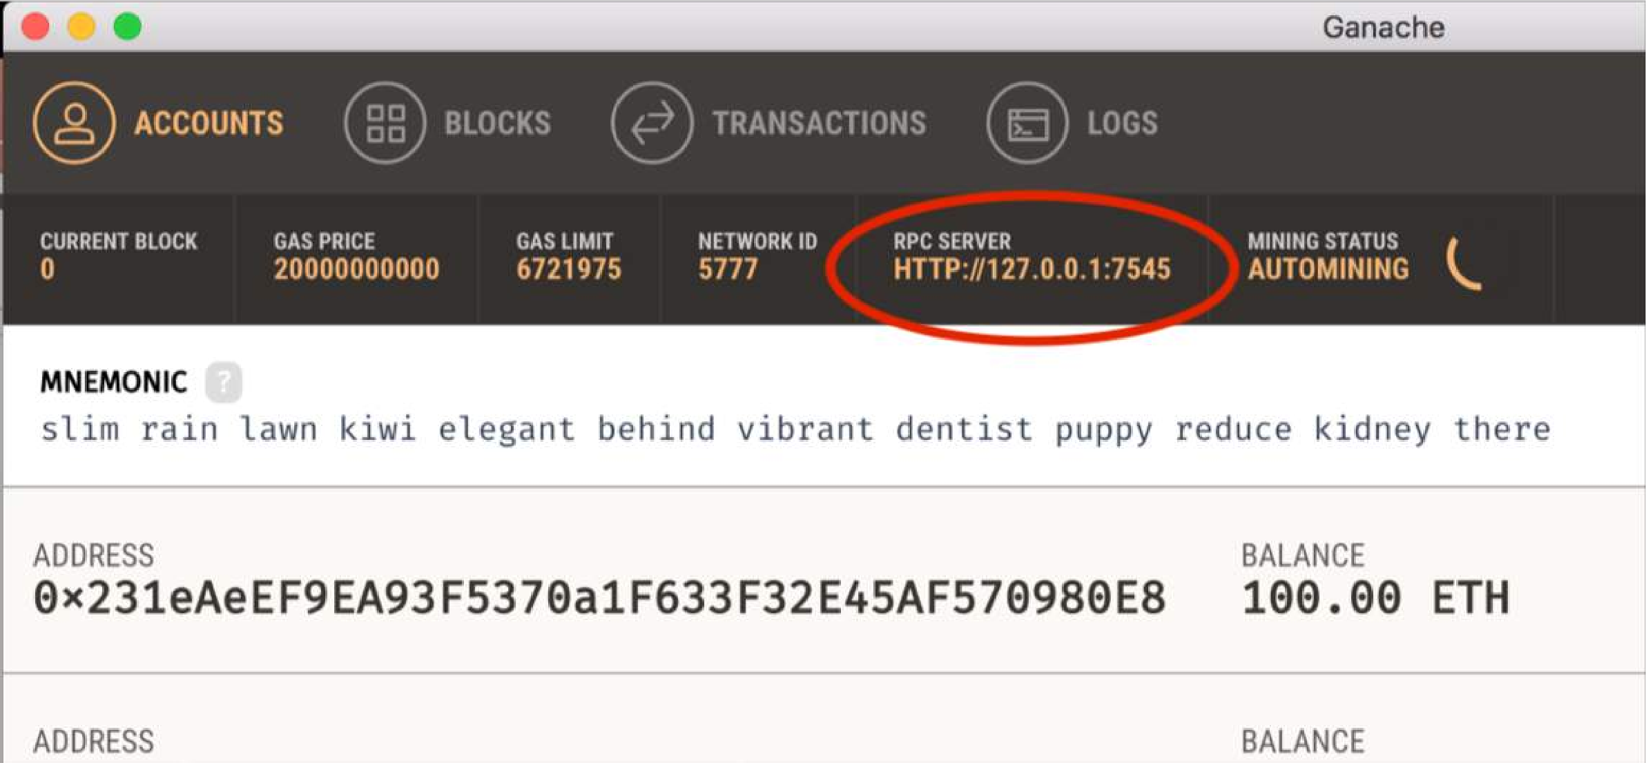

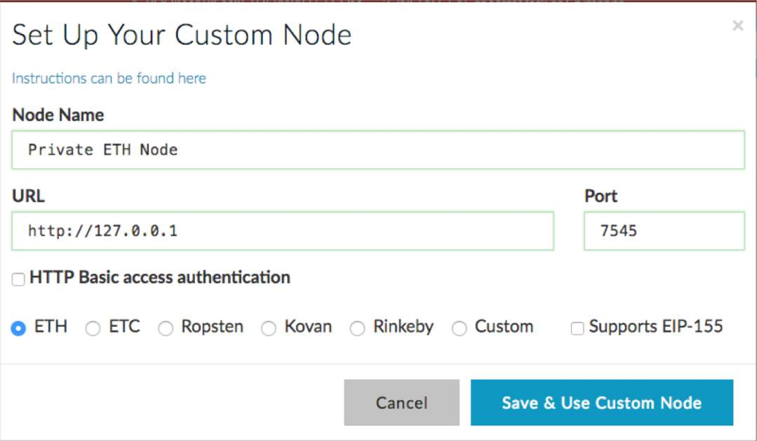
Import your RPC server address and the port number from Ganache to MyEtherWallet

Slide 28

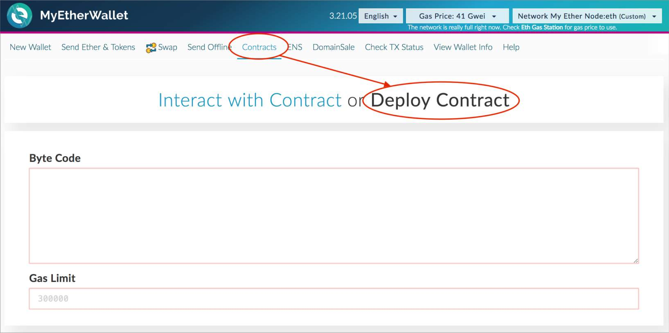
MyEtherWallet
Contracts tab: Deploy Contract

Slide 29
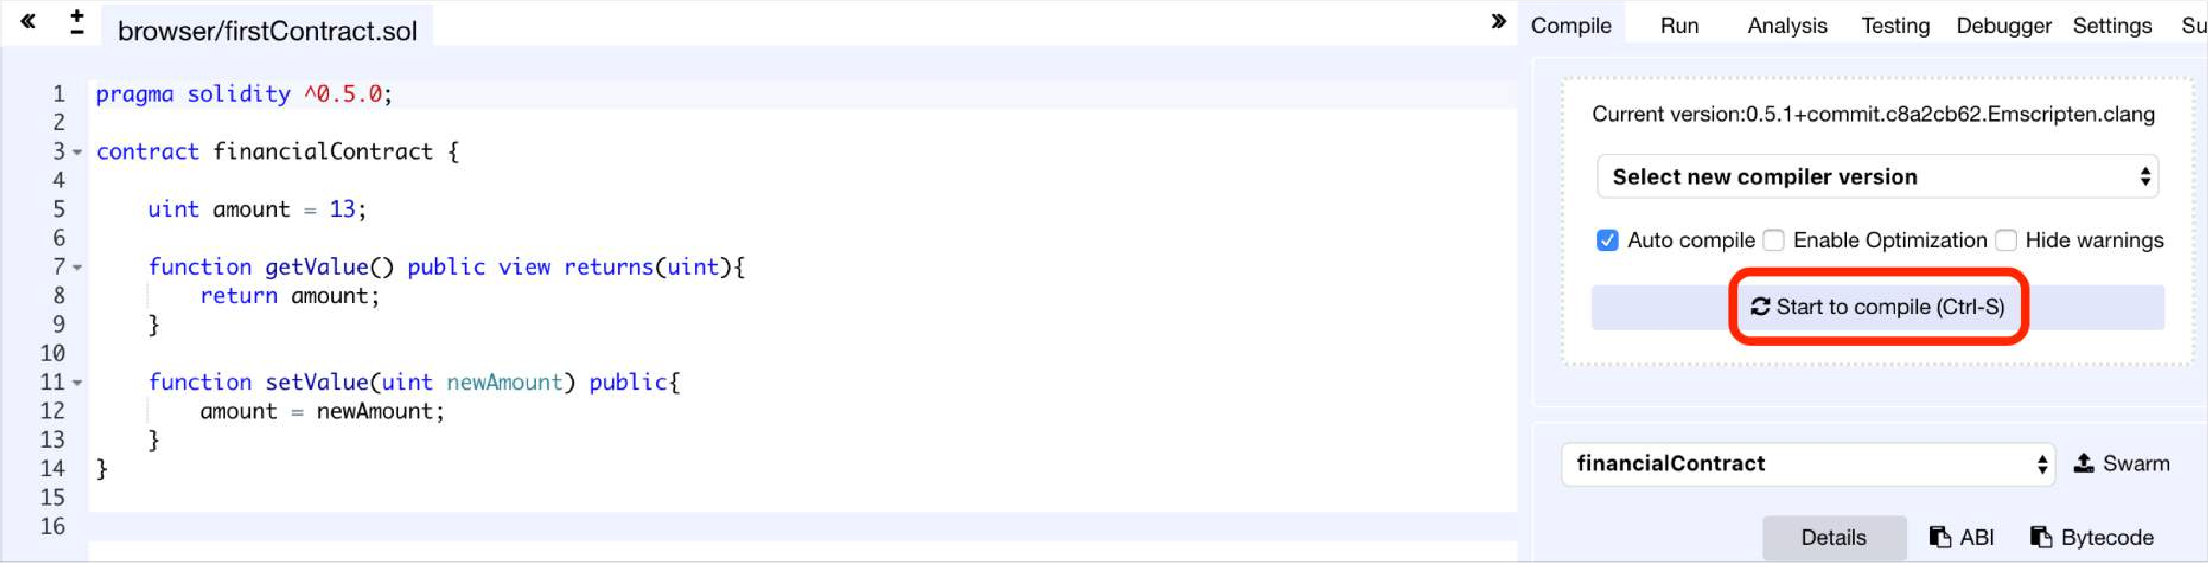
Remix
Type your contract and compile it

Slide 30
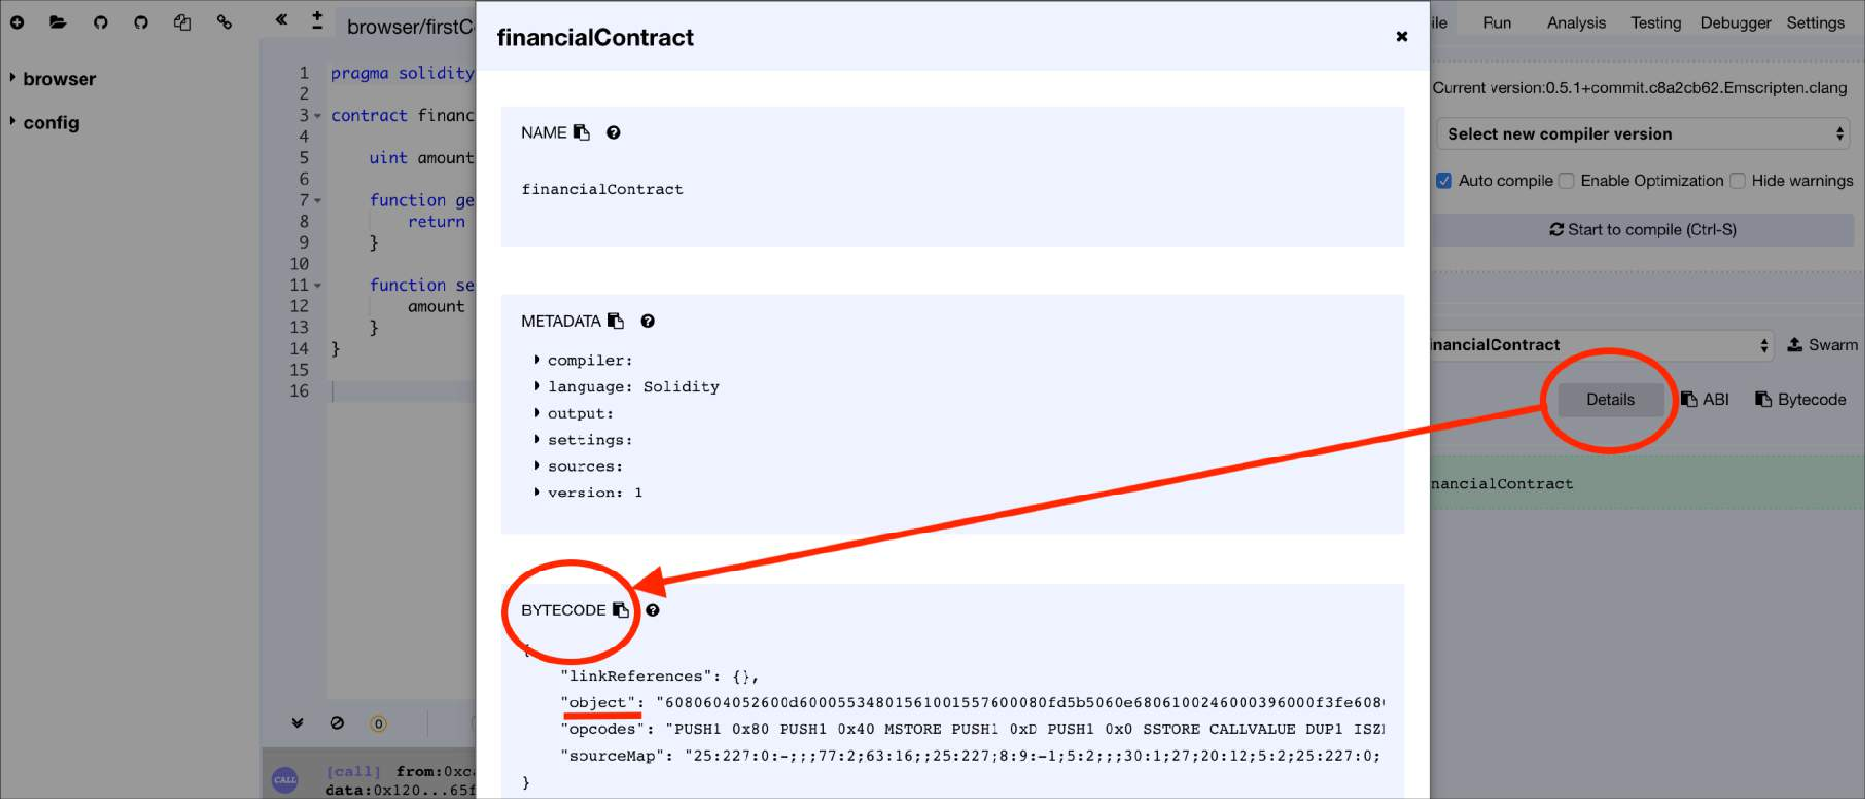
Remix
Click on Details Button: access ByteCode to import it to MyEtherWallet

Slide 31

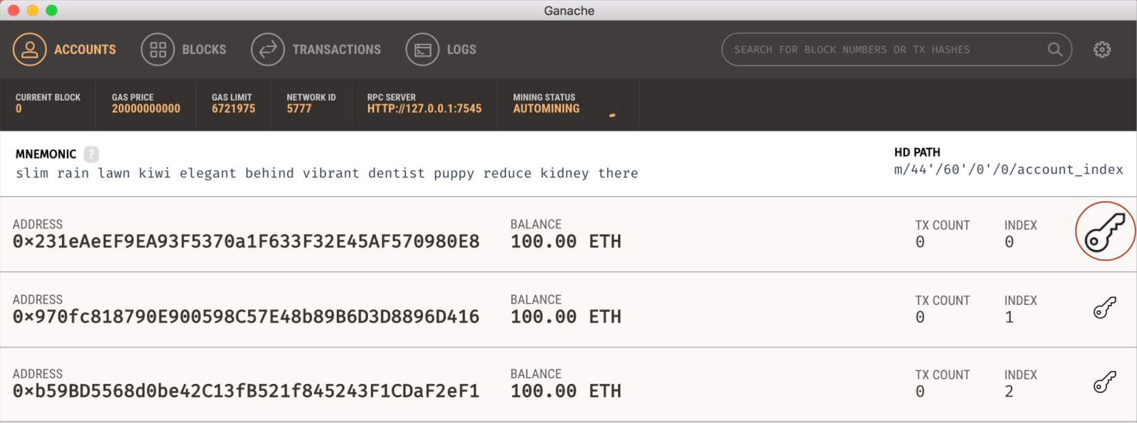

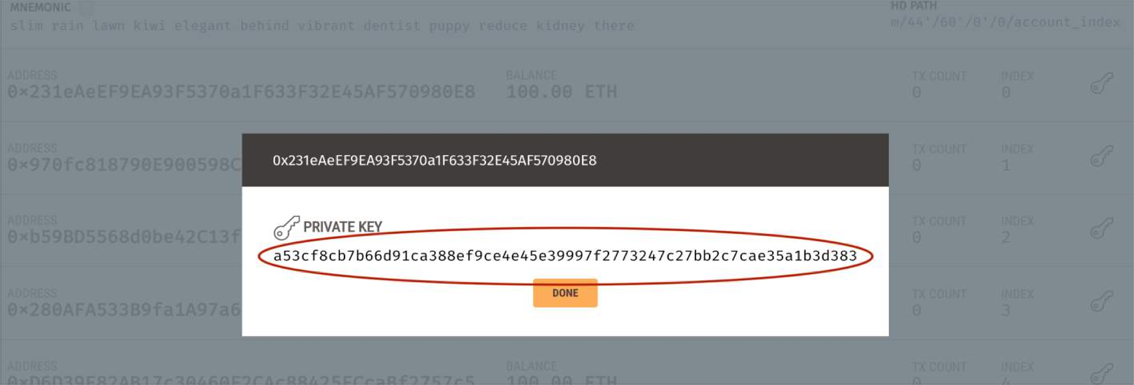
Ganache
Access your private key for signing your contract in MyEtherWallet.

Slide 32

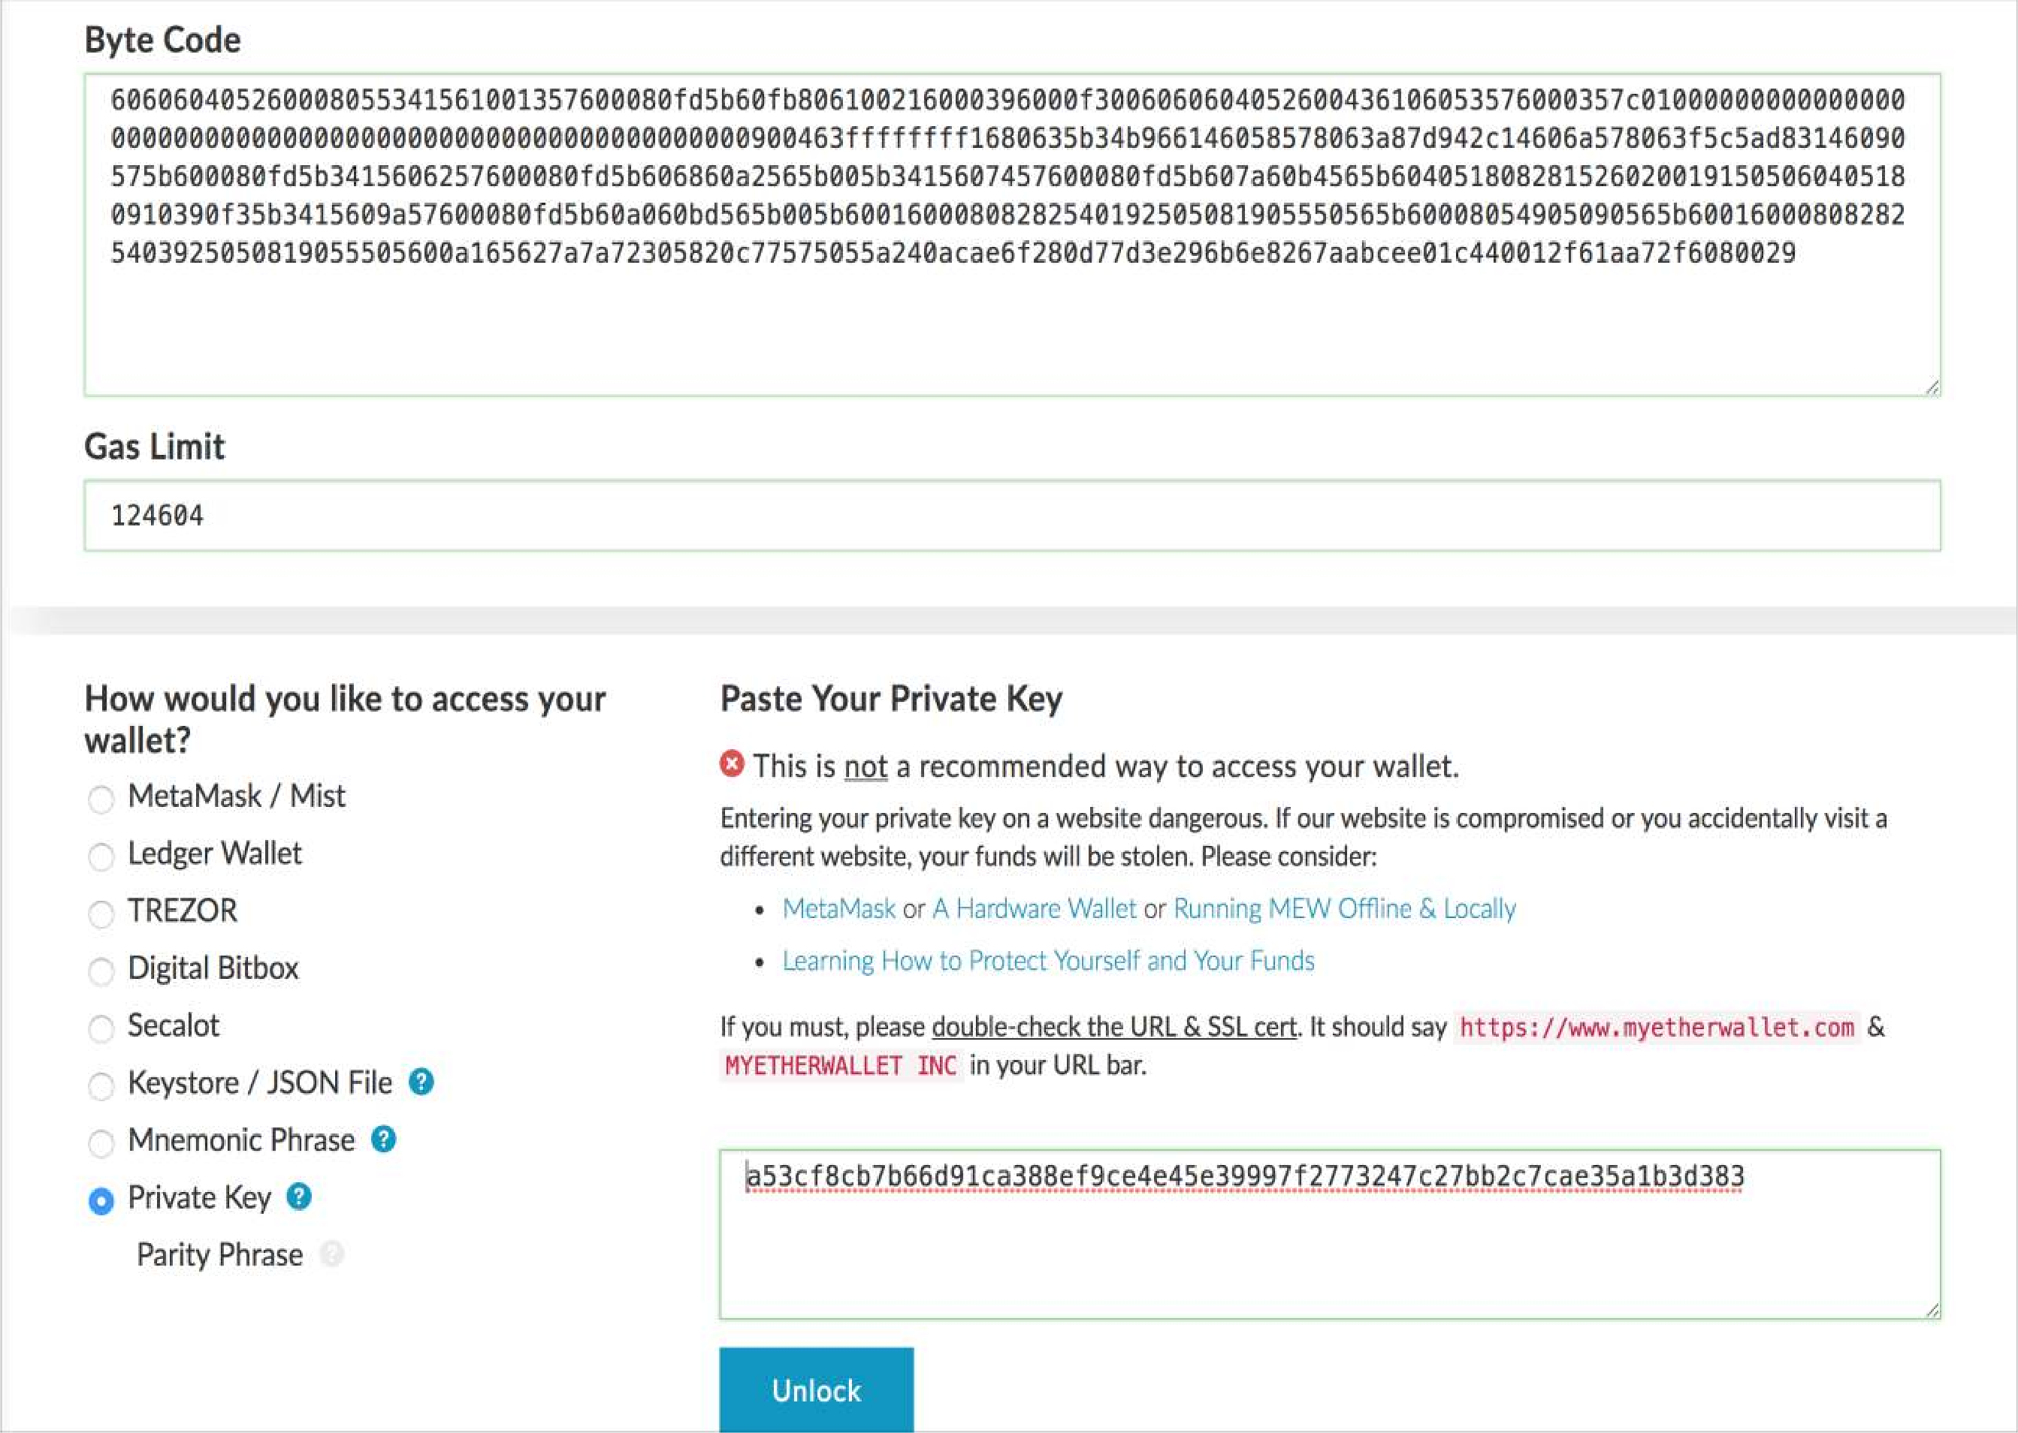
MyEtherWallet
Paste the contract’s ByteCode from Remix
Gas Limit will automatically be calculated
Paste your private key from Ganache
Click Unlock
Now you have access to your wallet
31

Slide 33

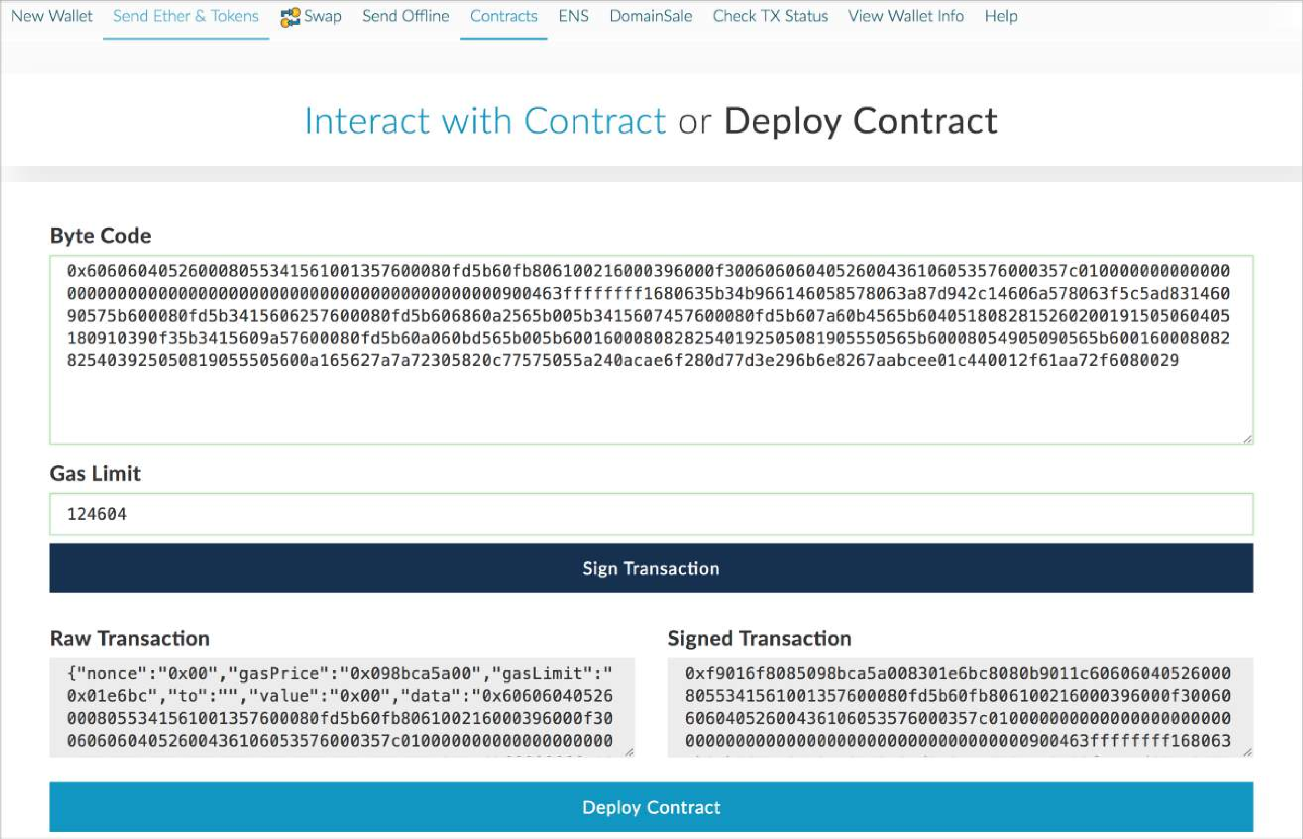
MyEtherWallet
Click on Sign Transaction button to deploy your contract

Slide 34

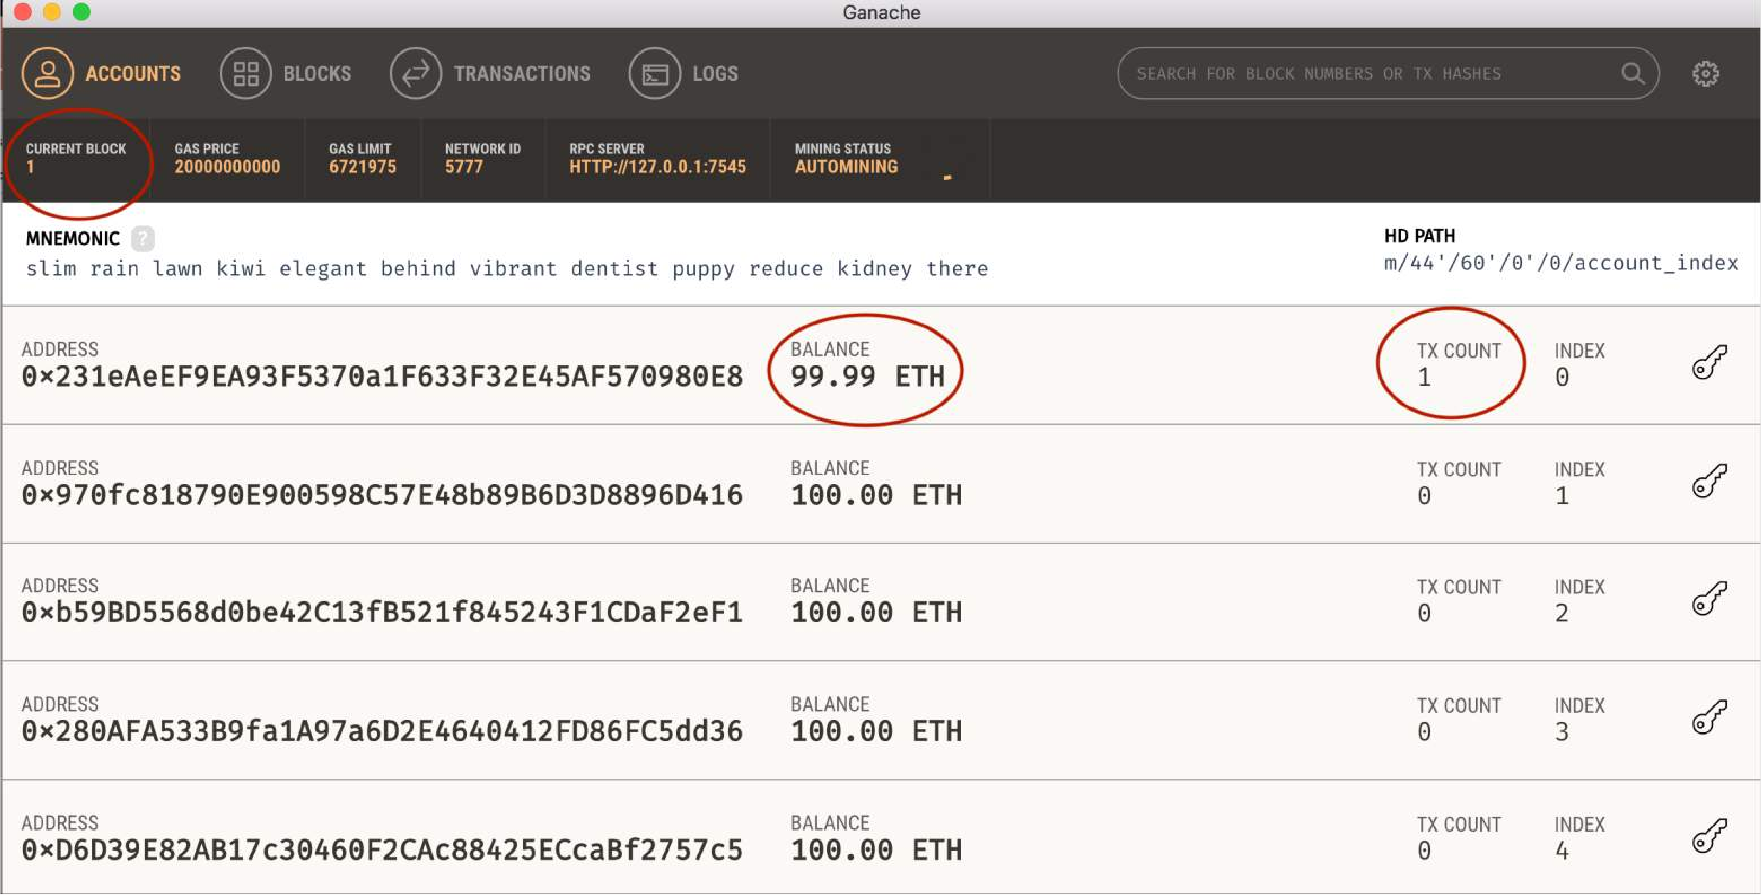
Ganache
You can see now you have one transaction for your address and your balance has been changed because of the amount of gas you paid for creating the contract.

Slide 35
Example Account
Private Key:
0x2dcef1bfb03d6a950f91c573616cdd778d9581690db1cc43141f7cca06fd08ee
Ethereum Private keys are 66 character strings (with 0x appended). Case is irrelevant. Same derivation through ECDSA as BTC.
Address:
0xA6fA5e50da698F6E4128994a4c1ED345E98Df50
Ethereum Private keys map to addresses directly. Simply the last 40 characters of the Keccak-256 hash of the public key. Address is 42 characters total (append 0x to front).

Slide 36
Transactions
A request to modify the state of the blockchain
Can run code (contracts) which change global state
Contrasts only balance updates in BTC
Signed by originating account
Types:
Send value from one account to another account
Create smart contract
Execute smart contract code

Slide 37
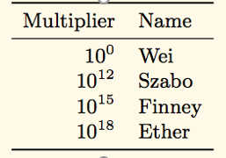
Ether Denominations
Wei - lowest denomination
Named after Wei Dai - author of b-money paper (1998), many core concepts used in BTC implementation
1/1,000,000,000,000,000,000 (quintillion)
Szabo - next denomination
Named after Nick Szabo - author of Bit-Gold
Finney – 2nd highest denomination
Named after Hal Finney - received first Tx from Nakamoto
http://www.weidai.com/bmoney.txt

Slide 38
Smart Contracts
Executable code
Turing Complete
Function like an external account
Hold funds
Can interact with other accounts and smart contracts
Contain code
Can be called through transactions

Slide 39
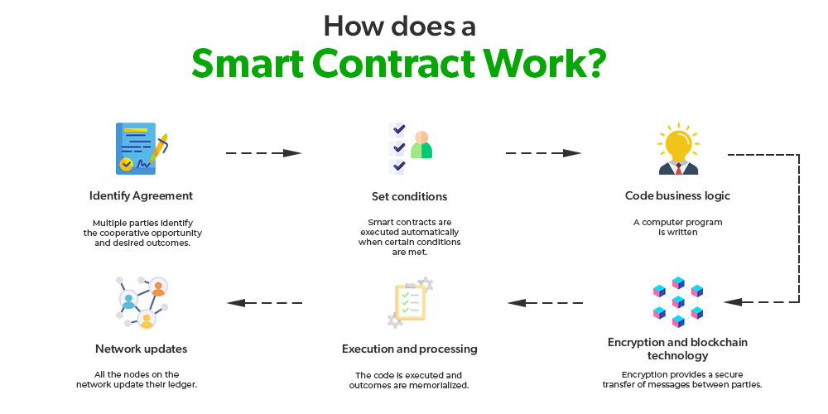
A Smart Contract is a computer program that directly and automatically controls the transfer of digital assets between the parties under certain conditions.
A smart contract works in the same way as a traditional contract while also automatically enforcing the contract.

Slide 40
Features of Smart Contracts
Distributed: Everyone on the network is guaranteed to have a copy of all the conditions of the smart contract and they cannot be changed by one of the parties. A smart contract is replicated and distributed by all the nodes connected to the network.
Deterministic: Smart contracts can only perform functions for which they are designed only when the required conditions are met. The final outcome will not vary, no matter who executes the smart contract.
Immutable: Once deployed smart contract cannot be changed, it can only be removed as long as the functionality is implemented previously.
Autonomy: There is no third party involved. The contract is made by you and shared between the parties. No intermediaries are involved which minimizes bullying and grants full authority to the dealing parties. Also, the smart contract is maintained and executed by all the nodes on the network, thus removing all the controlling power from any one party’s hand.
Customizable: Smart contracts have the ability for modification or we can say customization before being launched to do what the user wants it to do.
Transparent: Smart contracts are always stored on a public distributed ledger called blockchain due to which the code is visible to everyone, whether or not they are participants in the smart contract.
Trustless: These are not required by third parties to verify the integrity of the process or to check whether the required conditions are met.
Self-verifying: These are self-verifying due to automated possibilities.
Self-enforcing: These are self-enforcing when the conditions and rules are met at all stages.

Slide 41
Capabilities of Smart Contracts
Accuracy: Smart contracts are accurate to the limit a programmer has accurately coded them for execution.
Automation: Smart contracts can automate the tasks/ processes that are done manually.
Speed: Because everything is coded, the time taken to do all the work is the time taken for the code in the smart contract to execute.
Backup: Every node in the blockchain maintains the shared ledger, providing probably the best backup facility.
Security: Cryptography can make sure that the assets are safe and sound. Even if someone breaks the encryption, the hacker will have to modify all the blocks that come after the block which has been modified
Savings: Smart contracts save money as they eliminate the presence of intermediaries in the process. Also, the money spent on the paperwork is minimal to zero.
Manages information: Smart contract manages users’ agreement, and stores information about an application like domain registration, membership records, etc.
Multi-signature accounts: Smart contracts support multi-signature accounts to distribute funds as soon as all the parties involved confirm the agreement.

Slide 42
The idea behind smart contracts is pretty simple. They are executed on a basis of simple logic, IF-THEN for example:
IF you send object A, THEN the sum (of money, in cryptocurrency) will be transferred to you.
IF you transfer a certain amount of digital assets (cryptocurrency, for example, ether, bitcoin), THEN the A object will be transferred to you.
IF I finish the work, THEN the digital assets mentioned in the contract will be transferred to me.

Slide 43
Benefits of smart contracts
Compared to a human intermediary
Cheaper
Open and transparent program that fulfils the contract
and does nothing else
Does not peek into your data
Highly resistance to attacks
Compared to distributed databases
Rule-based rather than data-based
Rich language and (relative) easy of development
The collection of rules is transparent and reusable
May initiate and play an active role in the communication
May integrate and fuse data from multiple sources
3.1 ETHEREUM

Slide 44






Smart Contracts
Block 3
Block 4
Proof-of-Work: 00000090b41bx
Proof-of-Work:
000000r9d8fjj
Previous POW:
000000948fixf
Contract 102890h
Previous block: 00000090b41bx
Transaction D
Chainstate
Database
Transaction 1236foer
Transaction N
Transaction 4364rote
Transaction C
nonce 87874951
nonce 79146512
3.1 ETHEREUM
52

Slide 45
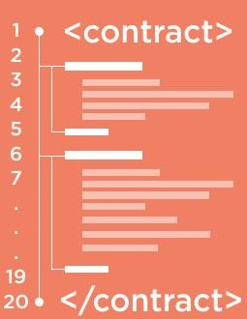
Smart Contracts
Contracts contain executable bytecode
Created with a blockchain tx
Contracts have internal storage
Block 3
Block 4
Proof-of-Work: 00000090b41bx
Proof-of-Work:
000000r9d8fjj
Previous POW:
000000948fixf
Contract 102890h
Previous block: 00000090b41bx
Transaction D
Chainstate
Database
Transaction 1236foer
Transaction N
Transaction 4364rote
Transaction C
nonce 87874951
nonce 79146512
3.1 ETHEREUM
52

Slide 46
Smart Contracts
Contracts contain executable bytecode
Created with a blockchain tx
Contracts have internal storage
Wallet ID | Held Titles
99823428347 | 34356,324324
98217981623 | 677343,4444
90987344755 | 994,38842,439
Contracts execute when triggered by a transaction (or by another contract) Execution time is limited by gas Example: Land registry
Block 3
Block 4
Proof-of-Work: 00000090b41bx
Proof-of-Work:
000000r9d8fjj
Previous POW:
000000948fixf
Contract 102890h
Previous block: 00000090b41bx
Transaction D
Chainstate
Database
Transaction 1236foer
Transaction N
Transaction 4364rote
Transaction C
nonce 87874951
nonce 79146512
3.1 ETHEREUM
52

Slide 47

Account State (“World State”)
Wallet ID | Balance | Code Hash | Internal State
99823428347 | 45.12 | - | 99554HGJ
98217981623 | 1123.332 | 9ERU12T4 | 3453ADFG
90987344755 | 9.3444 | 0490CNDJ | 132GJR4
Chainstate Database
3.1 ETHEREUM
53

Slide 48
Account State (“World State”)
Wallet ID | Balance | Code Hash | Internal State
99823428347 | 45.12 | - | 99554HGJ
98217981623 | 1123.332 | 9ERU12T4 | 3453ADFG
90987344755 | 9.3444 | 0490CNDJ | 132GJR4
Externally controlled account
Chainstate Database
3.1 ETHEREUM
53

Slide 49
Account State (“World State”)
Wallet ID | Balance | Code Hash | Internal State
99823428347 | 45.12 | - | 99554HGJ
98217981623 | 1123.332 | 9ERU12T4 | 3453ADFG
90987344755 | 9.3444 | 0490CNDJ | 132GJR4
Externally controlled account
Chainstate Database
Contract account
3.1 ETHEREUM
53

Slide 50

Account State (“World State”)
Wallet ID | Balance | Code Hash | Internal State
99823428347 | 45.12 | - | 99554HGJ
98217981623 | 1123.332 | 9ERU12T4 | 3453ADFG
90987344755 | 9.3444 | 0490CNDJ | 132GJR4
Externally controlled account
Chainstate Database
Contract account
3.1 ETHEREUM
53

Slide 51
Account State (“World State”)
Wallet ID | Balance | Code Hash | Internal State
99823428347 | 45.12 | - | 99554HGJ
98217981623 | 1123.332 | 9ERU12T4 | 3453ADFG
90987344755 | 9.3444 | 0490CNDJ | 132GJR4
Externally controlled account
…
Chainstate Database
Contract account
… …
Merkle Patricia Tree
3.1 ETHEREUM
53

Slide 52
Execution and Mining
Block 4
Proof-of-Work:
000000r9d8fjj
Previous block:
00000090b41bx
Transaction
Trie
State Trie
Root Hash
Receipts
Trie Root Hash
Chainstate Database
3.1 ETHEREUM
ZHANG, VITENBERG, JACOBSEN © 2018
54

Slide 53
Execution and Mining
Transaction C
(by Alice)
Inputs
Outputs
Gas limit
Gas price
Block 4
Contains all transactions in the block structured as a Merkle Tree
Proof-of-Work:
000000r9d8fjj
Previous block:
00000090b41bx
Transaction
Trie
Transaction fee = max(gas_limit, gas_price x steps + storage fees)
State Trie
Root Hash
Receipts
Trie Root Hash
Chainstate Database
3.1 ETHEREUM
ZHANG, VITENBERG, JACOBSEN © 2018
54

Slide 54
Execution and Mining
Transaction C
(by Alice)
Inputs
Outputs
Gas limit
Gas price
Block 4
Contains all transactions in the block structured as a Merkle Tree
Proof-of-Work:
000000r9d8fjj
Previous block:
00000090b41bx
Transaction
Trie
Transaction fee = max(gas_limit, gas_price x steps + storage fees)
State Trie
Root Hash
Root Hash of the Merkle Patricia Tree after txs are applied
Receipts
Trie Root Hash
Chainstate Database
3.1 ETHEREUM
ZHANG, VITENBERG, JACOBSEN © 2018
54

Slide 55
Execution and Mining
Transaction C
(by Alice)
Inputs
Outputs
Gas limit
Gas price
Block 4
Contains all transactions in the block structured as a Merkle Tree
Proof-of-Work:
000000r9d8fjj
Previous block:
00000090b41bx
Transaction
Trie
Transaction fee = max(gas_limit, gas_price x steps + storage fees)
State Trie
Root Hash
Root Hash of the Merkle Patricia Tree after txs are applied
Receipts
Trie Root Hash
Log the outcome of each transaction externally
Chainstate Database
3.1 ETHEREUM
ZHANG, VITENBERG, JACOBSEN © 2018
54

Slide 56
Comparison with Bitcoin
 | Bitcoin | Ethereum
Transactions | Transfer of bitcoins | Contract creation, transfer of ether, contract calls, internal transactions
Accounts | User wallets | Externally owned accounts, contract accounts
Transaction fees | Amount specified by sender | Gas calculated using sender’s values
Block content | Transactions trie | Transactions, State Root Hash, Receipts Root Hash
Chainstate Database | World state: UTXOs for wallets | World state, receipts, bytecodes for contracts
Querying | Simple Payment Verification | Merkle proofs for events, transactions, balance, etc.
3.1 ETHEREUM
55

Slide 57
Ethereum Gas
"Gas limit" is the maximum amount of work you're estimating a validator will do on a particular transaction.
A higher gas limit usually means the user believes the transaction will require more work.
"Gas price" is the price per unit of work done. So, a transaction cost is the gas limit multiplied by the gas price.

Slide 58
Code Execution
Every node contains a virtual machine (similar to Java)
Called the Ethereum Virtual Machine (EVM)
Compiles code from high-level language to bytecode
Executes smart contract code and broadcasts state
Every full-node on the blockchain processes every transaction and stores the entire state

Slide 59
Gas
Halting problem (infinite loop) – reason for Gas
Problem: Cannot tell whether or not a program will run infinitely from compiled code
Solution: charge fee per computational step to limit infinite loops and stop flawed code from executing
Every transaction needs to specify an estimate of the amount of gas it will spend
Essentially a measure of how much one is willing to spend on a transaction, even if buggy

Slide 60
Gas Cost
Gas Price: current market price of a unit of Gas (in Wei)
Check gas price here: https://ethgasstation.info/
Is always set before a transaction by user
Gas Limit: maximum amount of Gas user is willing to spend
Helps to regulate load on network
Gas Cost (used when sending transactions) is calculated by gasLimit*gasPrice.
All blocks have a Gas Limit (maximum Gas each block can use)

Slide 61
Interacting with the smart contract
Extract the contract address from Ganache
Extract the ABI (Application Binary Interface) of the code from Remix
Interact with the contract in MyEtherWallet
(Import the contract address and the ABI into the MyEtherWallet)
Select a function
Write
Pay some gas
Read
Generate the transaction
Receive the result

Slide 62
Create Custom Ethereum Blockchain
Instead of using Ganache with its default properties for private blockchain you can run your own blockchain
Install Geth: One of the implementations of Ethereum written in Go
Create the genesis block
Create storage of the blockchain
Deploy blockchain nodes
Connect MyEtherWallet to your blockchain to interact with it

Slide 63
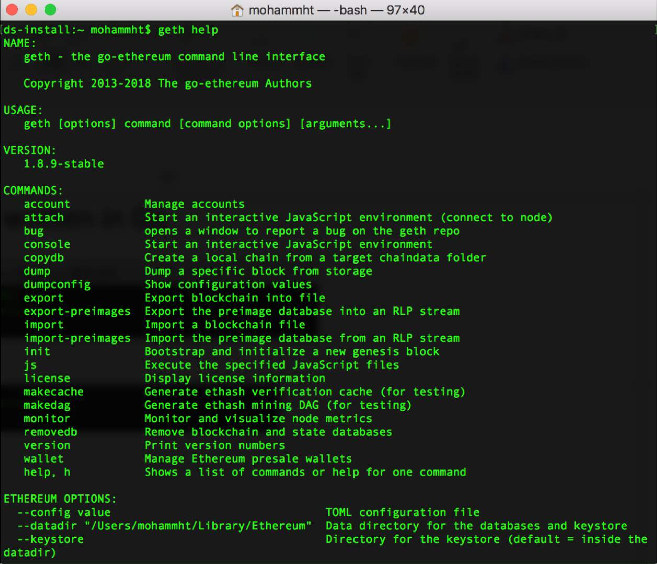
Geth help

Slide 64
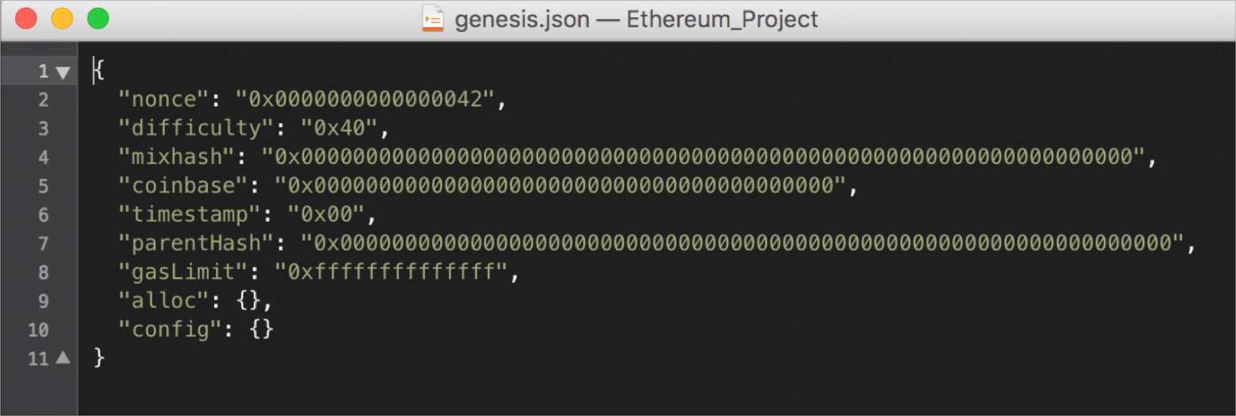
Genesis block
The first block in the chain and a json file that stores the configuration of the chain
Create and store the file as genesis.json

Slide 65

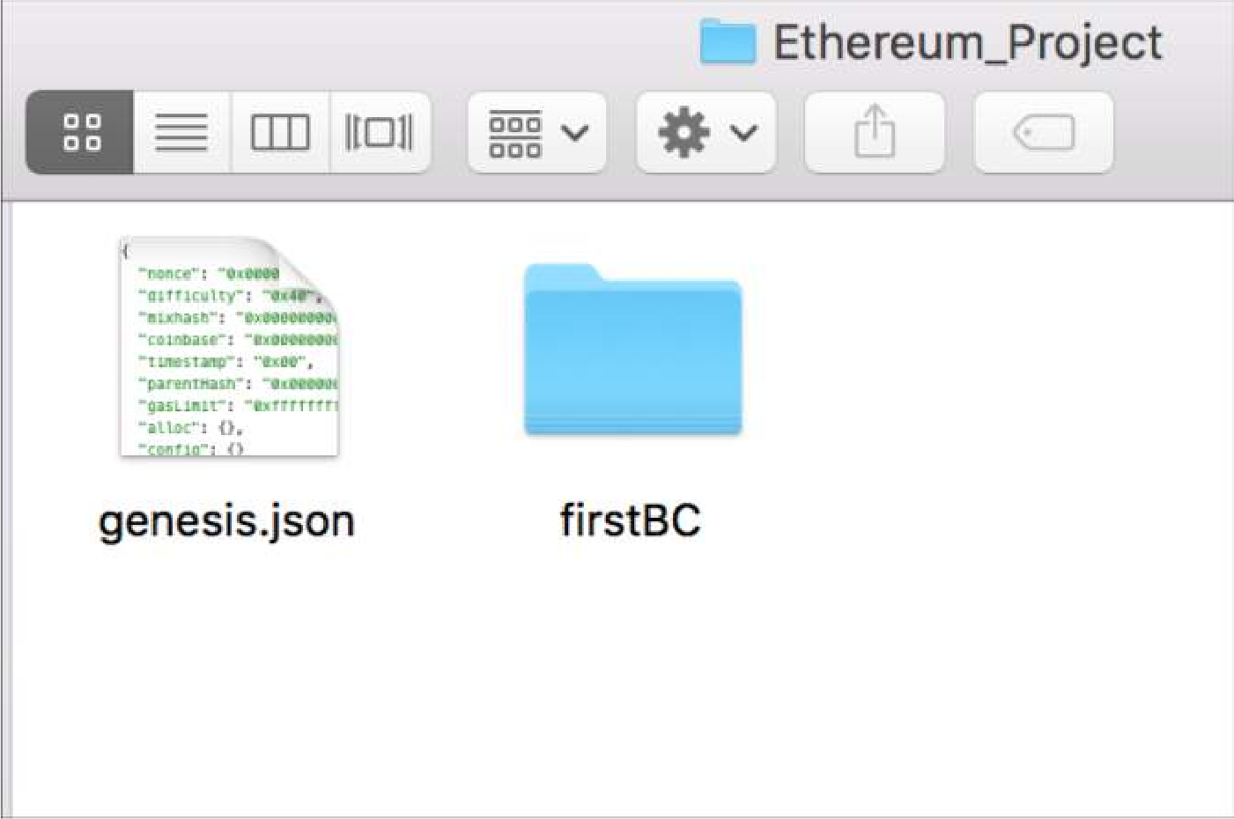
Create the storage of the blockchain
Go to the directory of the genesis.json file
Specify directory of your blockchain
Create the storage from the genesis block
Folder name of your blockchain

Slide 66

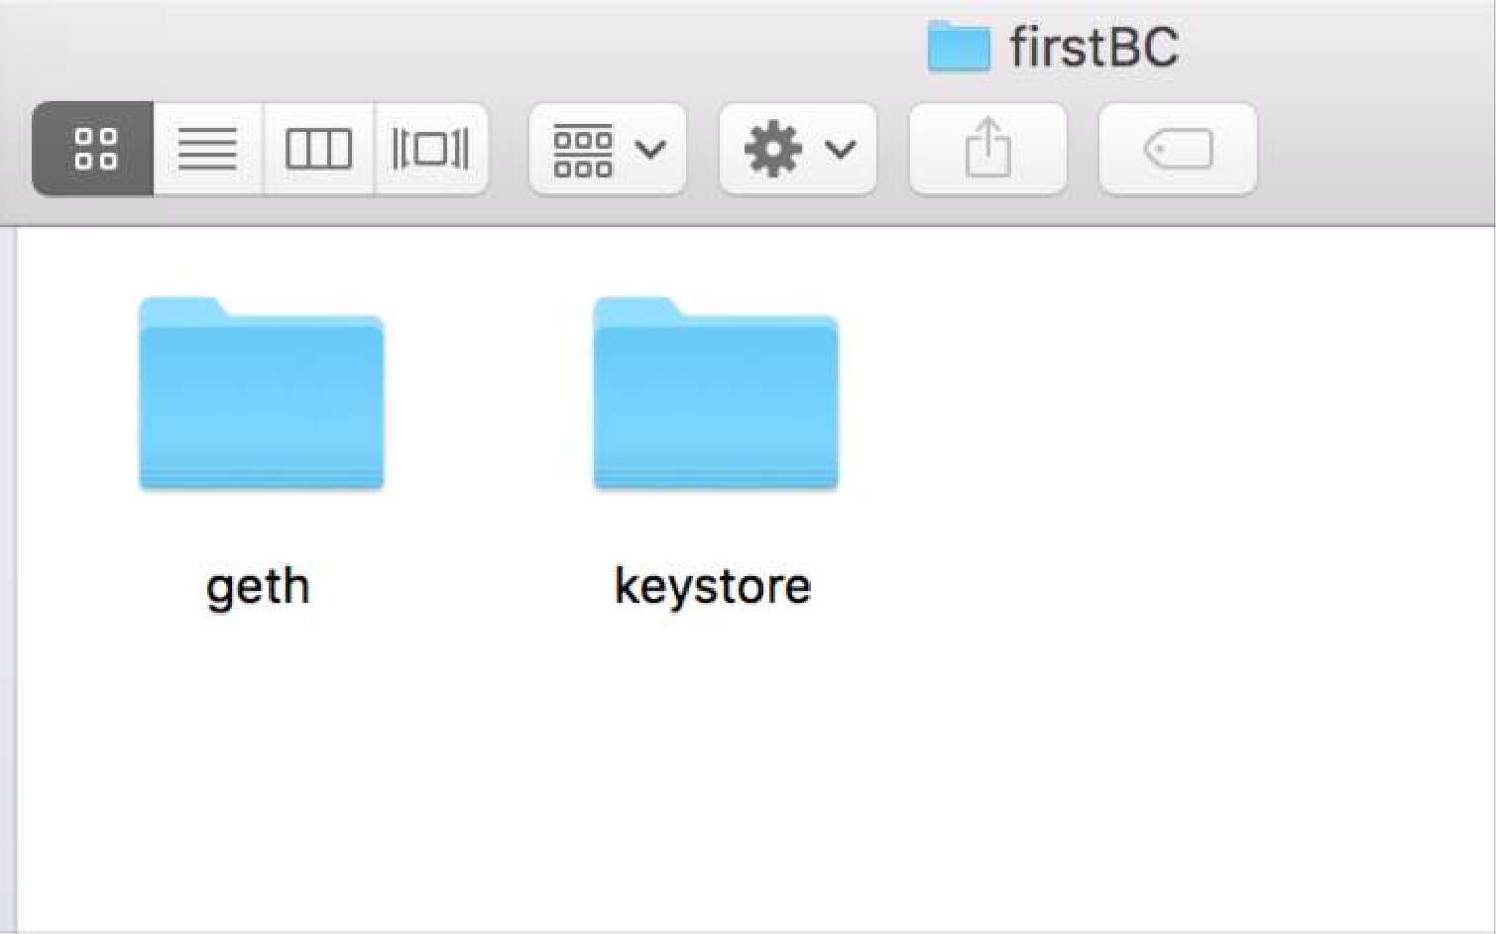
Inside the Blockchain Folder
geth folder: Store your database
keystore: Store your Ethereum accounts

Slide 67
Start the Ethereum peer node
Start the blockchain
Networkid provides privacy for your network.
Other peers joining your network must use the same networkid.

Slide 68
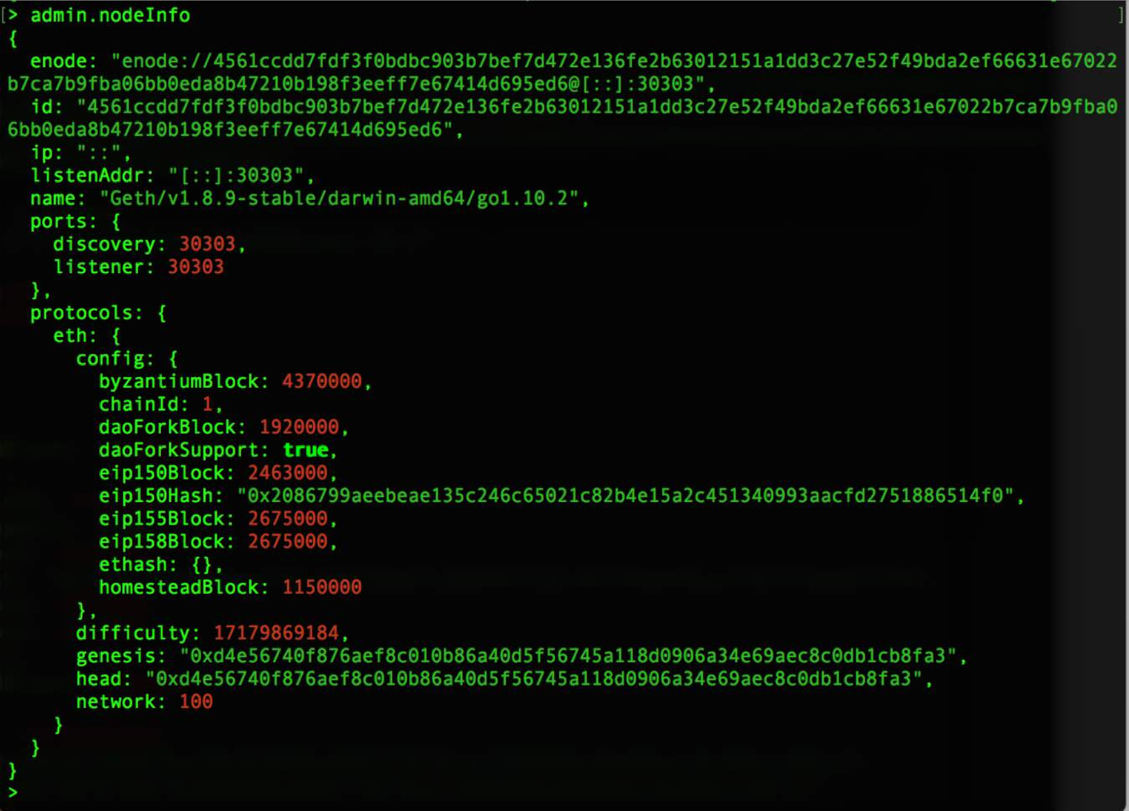
Blockchain started
Type admin.nodeInfo to get the information about your current node

Slide 69
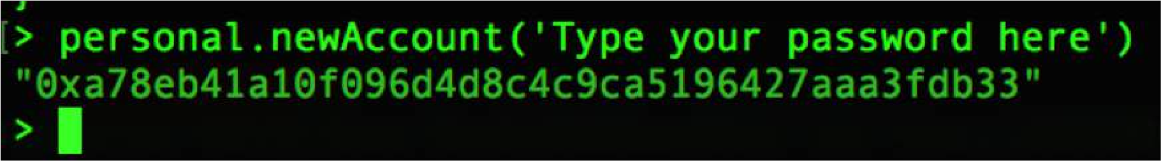
Create an account
Type personal.newAccount to create as many accounts as you need
See the created account(s)

Slide 70
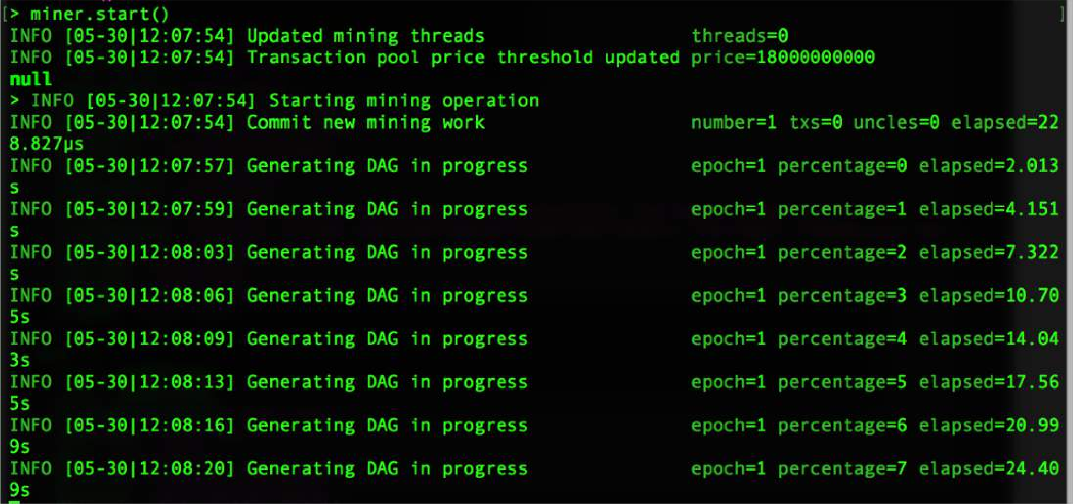
Mining
Type miner.start() to start mining
Type miner.stop() to stop mining

